Slide 1
HOTSeALS-TERIFIC
Exploratory Data Analysis
Nicolai von Oppeln-Bronikowski

Slide 2
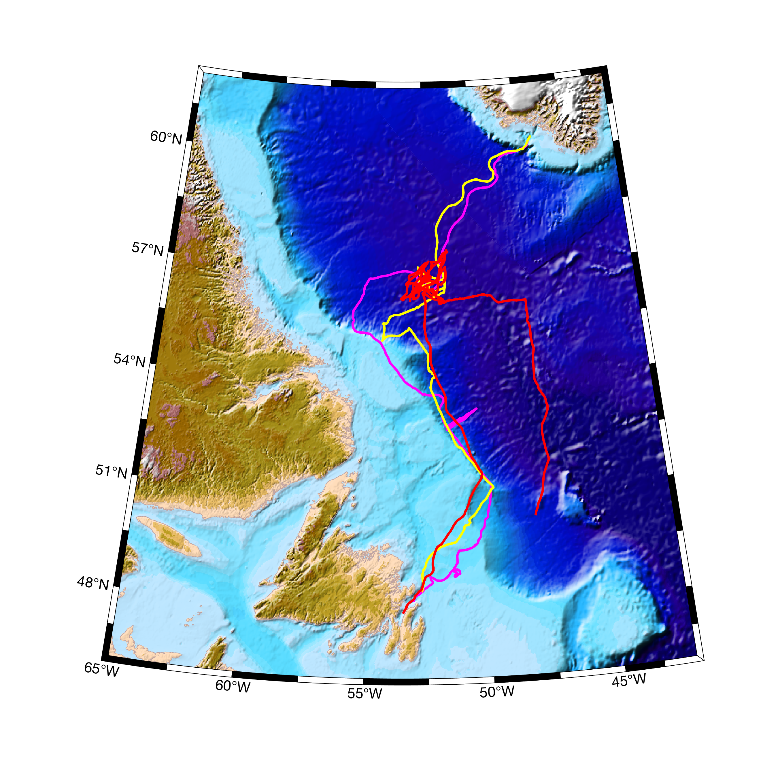
3 Gliders in Labrador Sea 2020 Convection Season

Slide 3
Pearldiver Slocum G2
Extended Bay, S3 Lithium Primaries
Mission duration 7 Months, 4527 km, 207 days, 663 surfacing's
>2500 CTD Profiles, but some data gaps (not recoverable)
CTD, O2 resolution ~ 20 second sampling for most of the mission
One 3 day experiment running all sensors at ~ 1 Hz, but the science computer nearly crashed so this was not sustainable
Several eddy-like events
Deepest mixed profiles >1000 m, from February to April.

Slide 4
Seaglider “Scappa” & Ziggy”
Launched from Greenland (Qaqortoq) from small vessel (Adolf Jansen) in Middle of December
Arrived in Central Labrador Sea beginning of February
Scappa? Transect on to Labrador Shelf Ziggy transect near 53 north
Left Central Labrador Sea in end of March towards recovery in Trininty Bay, Newfoundland
Ended mission with ~1-4% battery remaining?

Slide 5
Pearldiver Glider Data

Slide 6
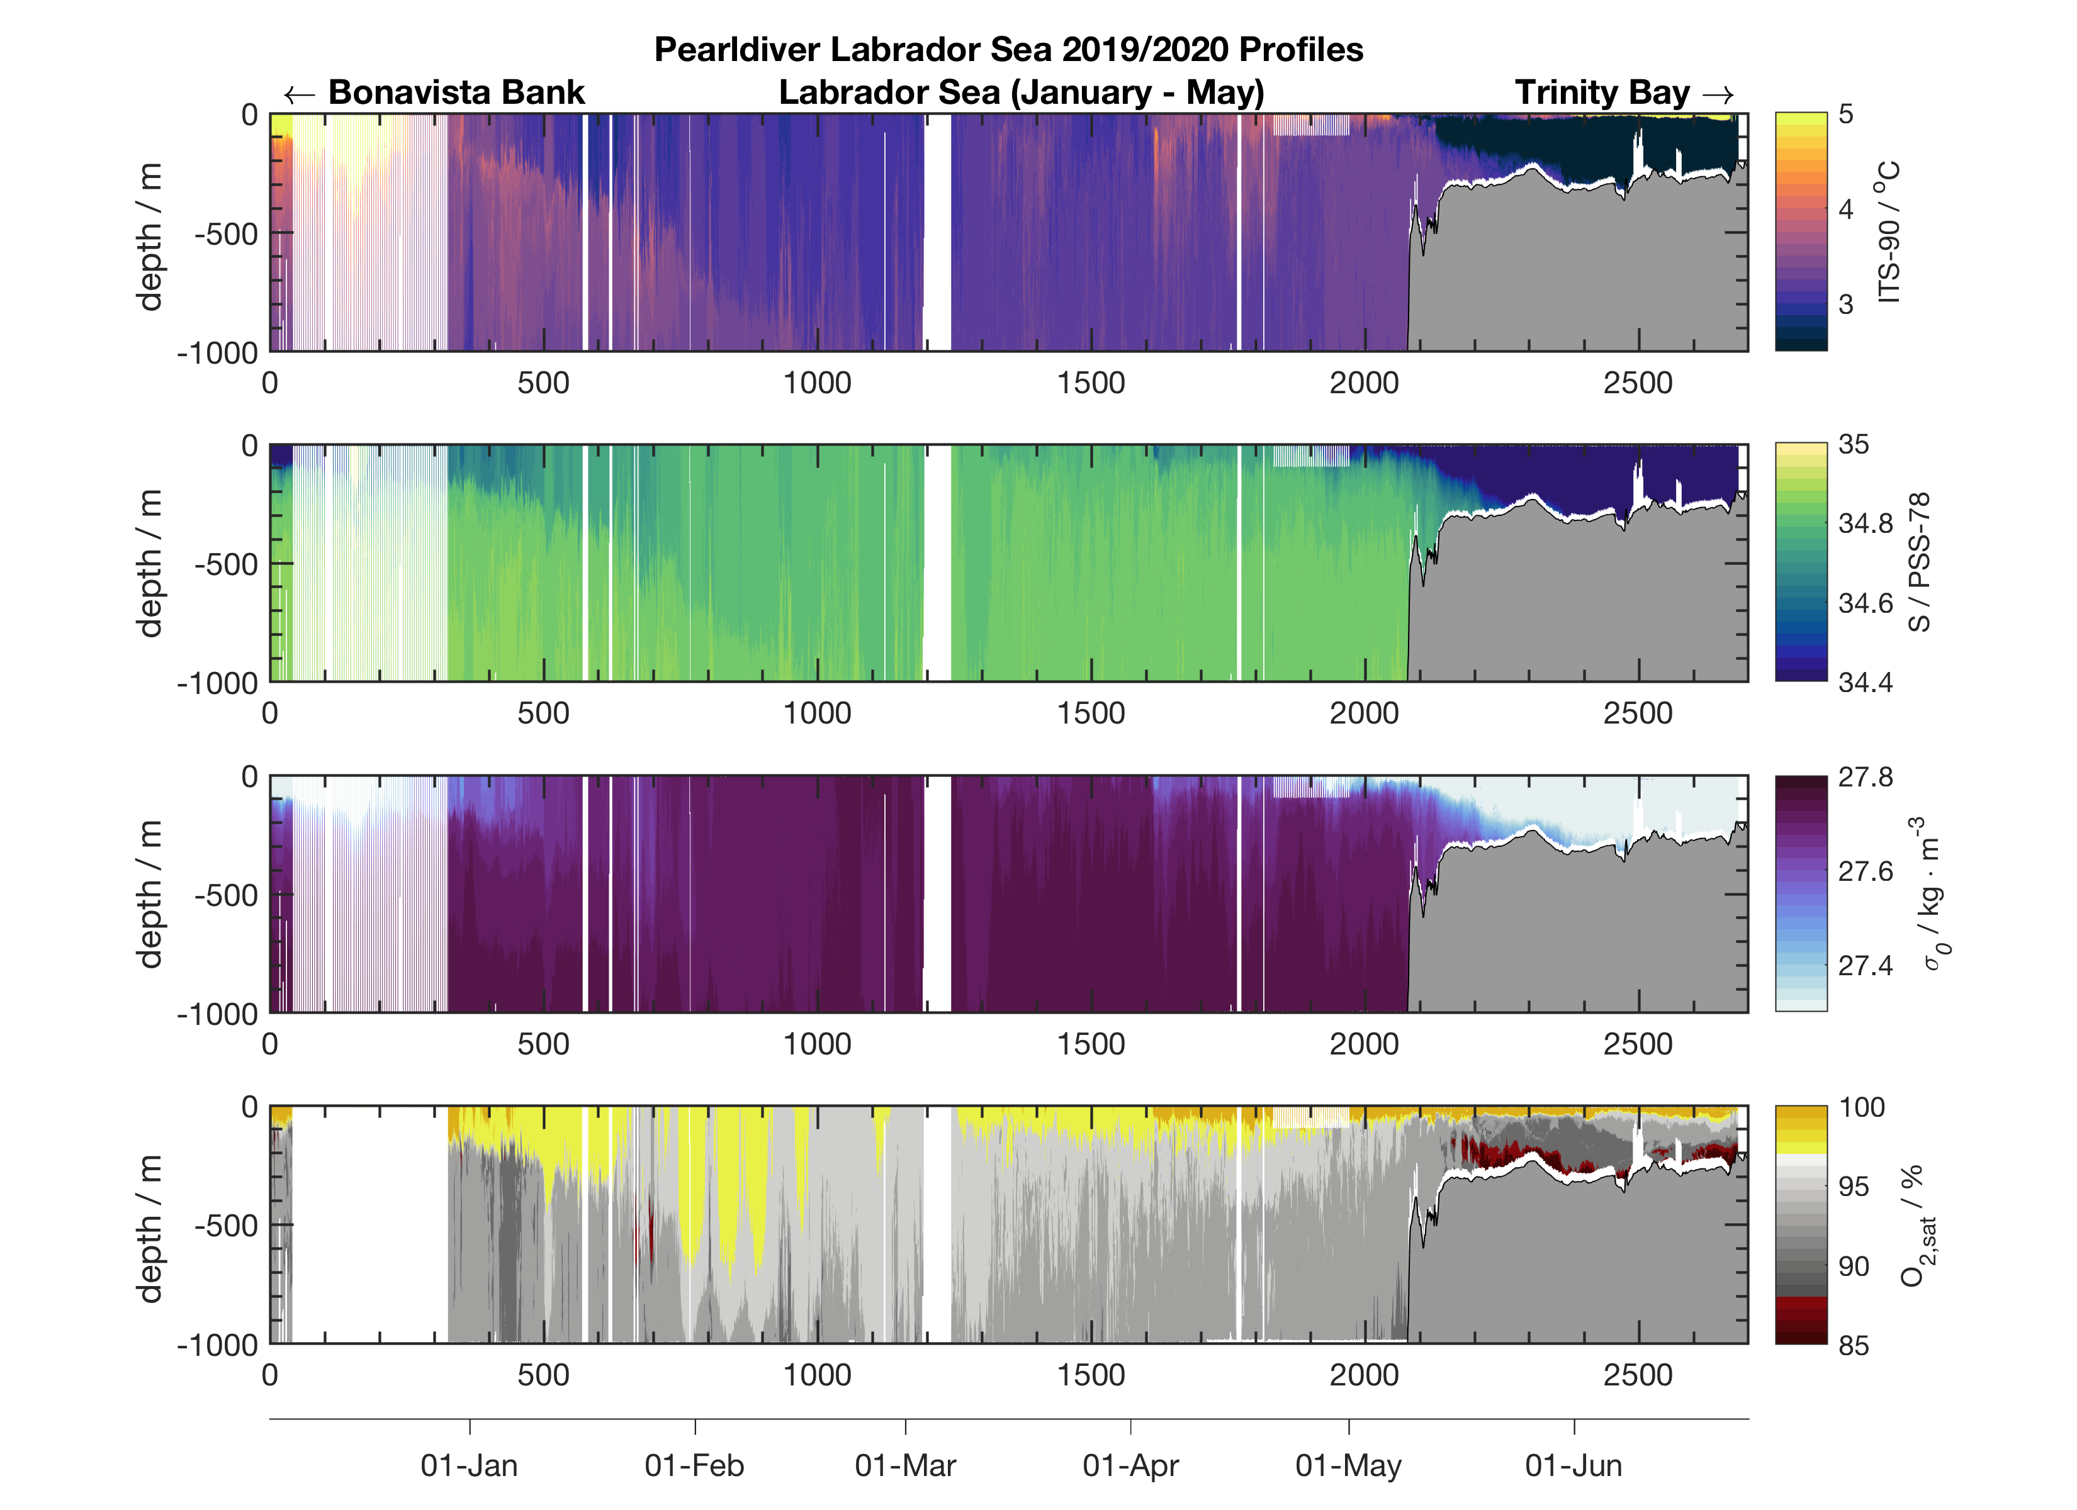
Processed all Slocum Glider Data, performed QC, some validation checks

Slide 7
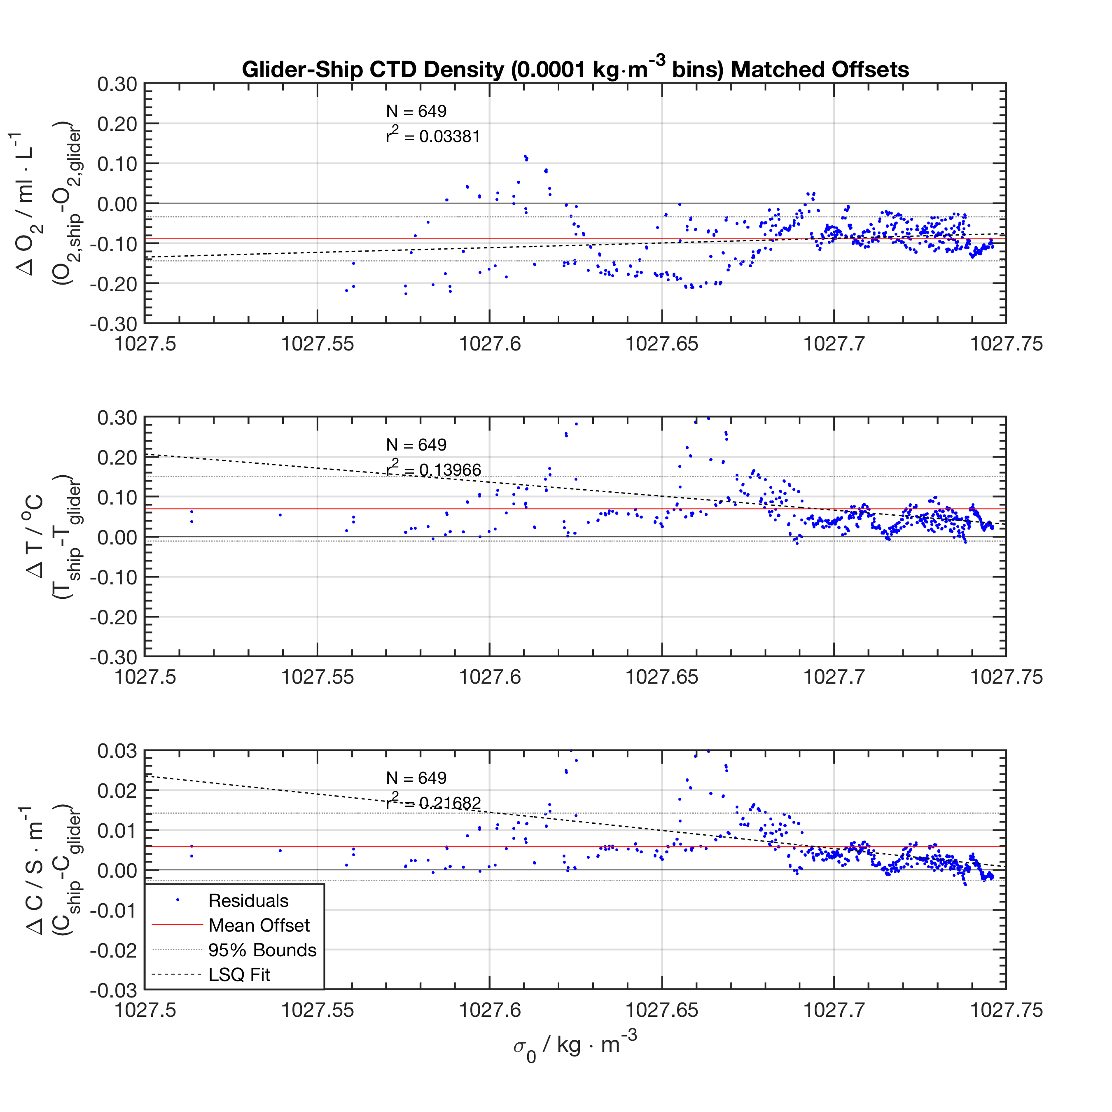
Validation Step 1: Ship Cast Comparison with JC 190
 | Temperature [deg C] | Conductivity [S / m] | Salinity [PSU] | Oxygen [ml/L]
Mean | 0.0697 | 0.0058 | 0.0130 | -0.0887
Median | 0.0476 | 0.0034 | 0.0109 | -0.0850
Std. Dev. | 0.0809 | 0.0084 | 0.0098 | 0.0550
Min | -0.0173 | -0.0038 | 0.0006 | -0.3711
Max | 0.4752 | 0.0466 | 0.0623 | 0.1178
Table summarizes statistics off comparing first 4 dive profiles from the glider with the 1200 m profile from James Cook upon glider deployment Dec 04, 2019. 0.0001 kg m^3 density bins used for offset computation. Linear fits generated (linear-least-squares + N = 649).
We know that T acc. is better than 0.01 and that C is better than 0.005. We can see that O2 is at least 0.1 ml/L or better. That is about 4.46 micromol/L which is about the accuracy given by the manufacturer for in-range calibration of the sensor. Linear fit not a good estimate

Slide 8
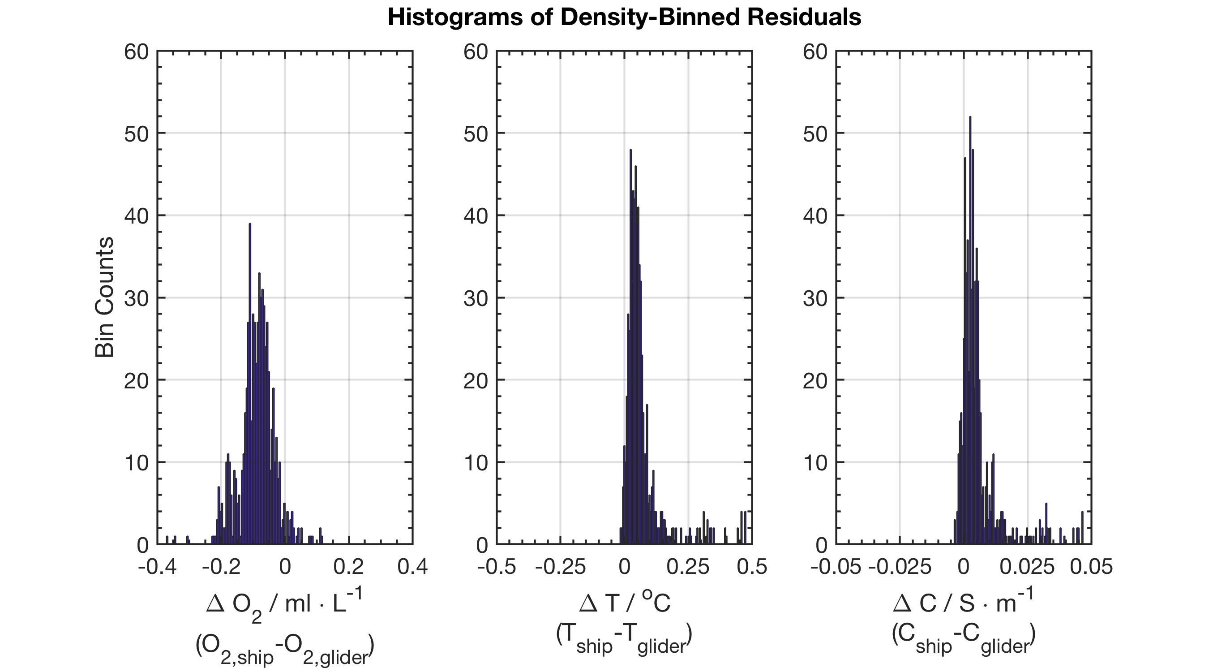
Validation Step 1: Ship Cast Comparison with JC 190

Slide 9
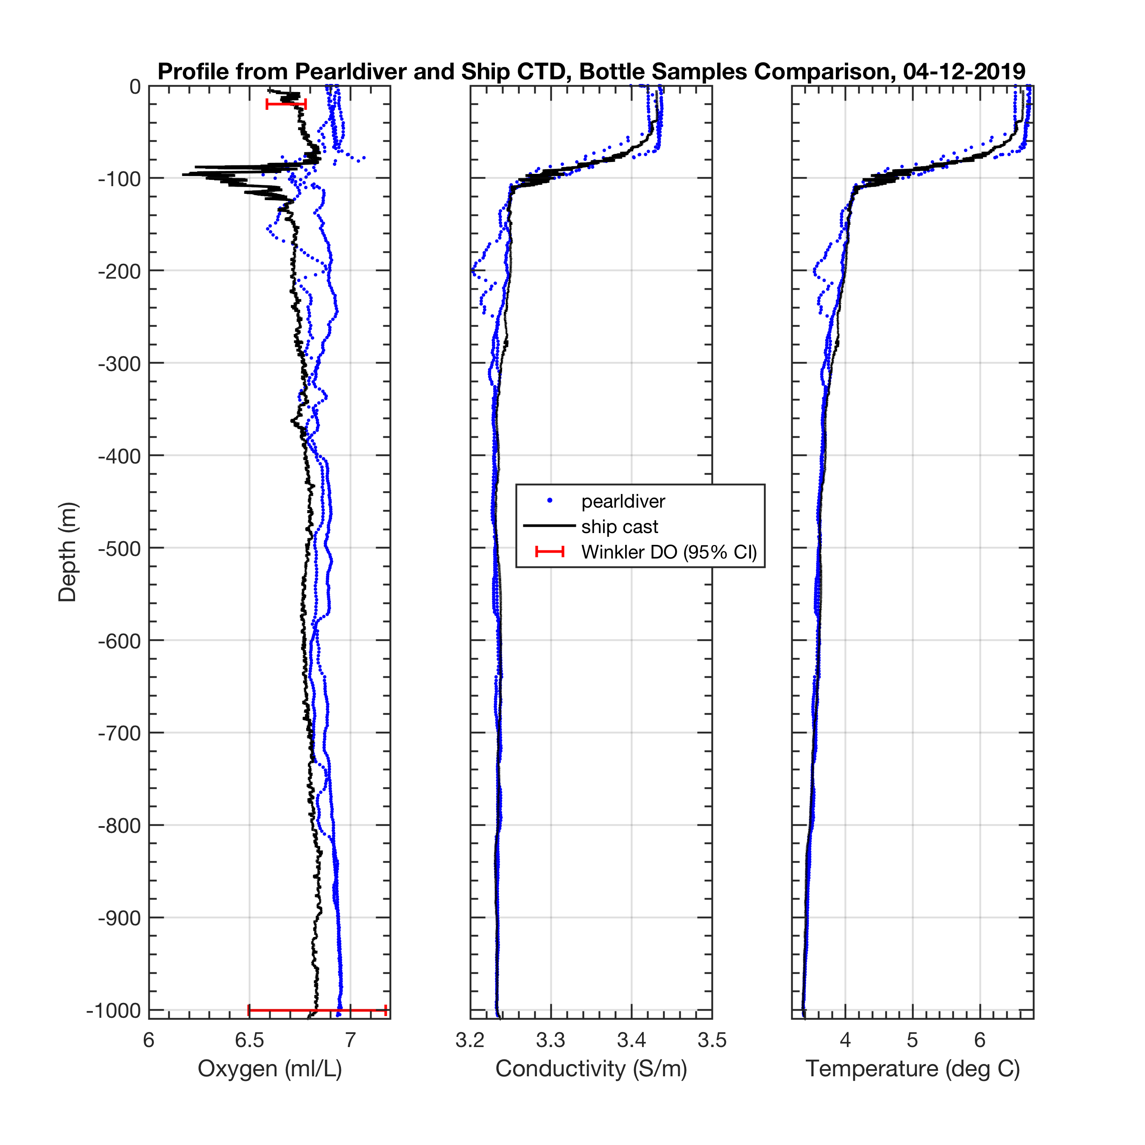
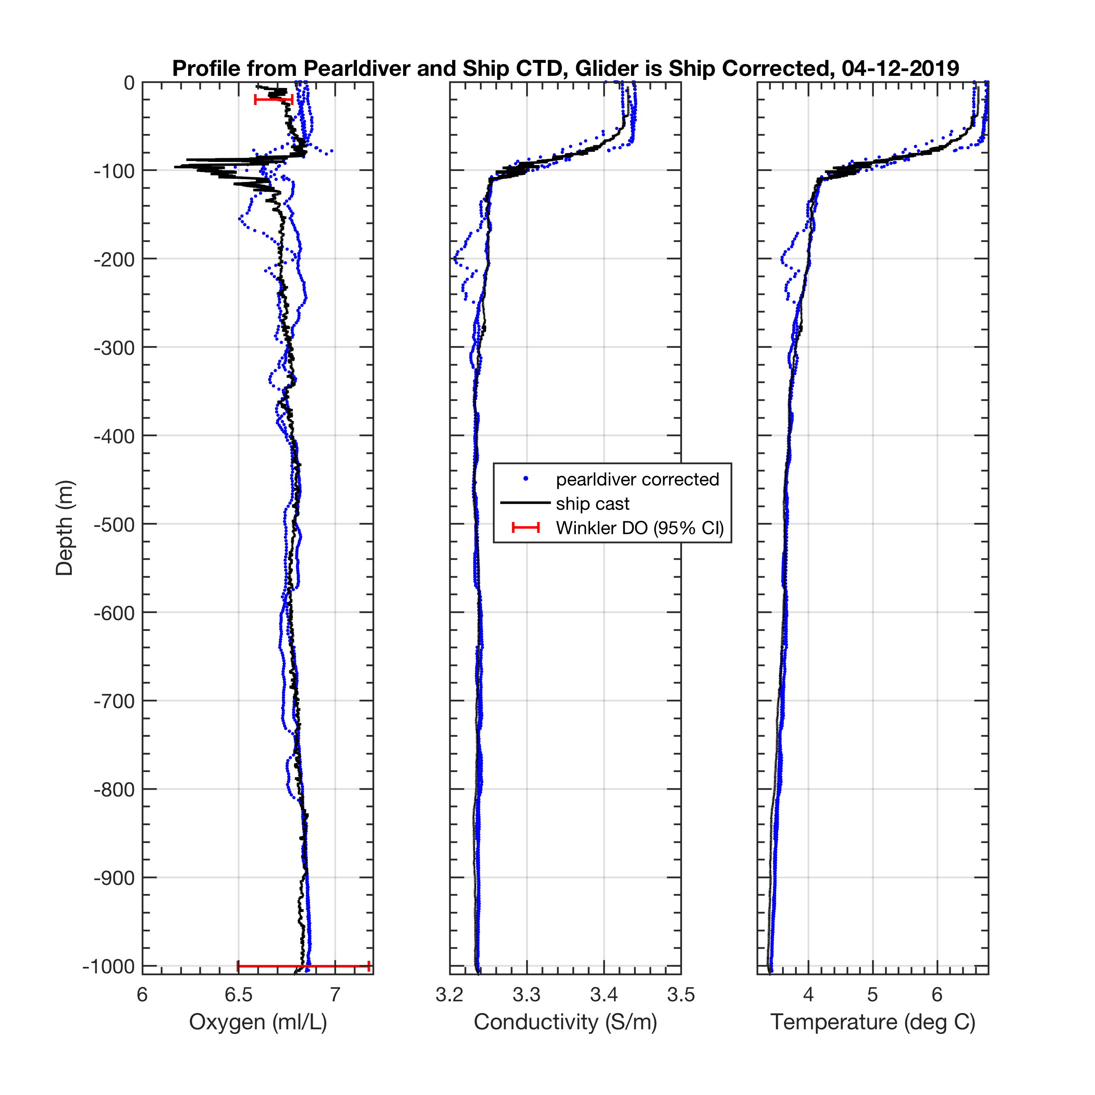
Validation Step 1: Ship Cast Comparison with JC 190
Applying median offsets
We can see an improved match, in O2, but not noticeably in T and C

Slide 10
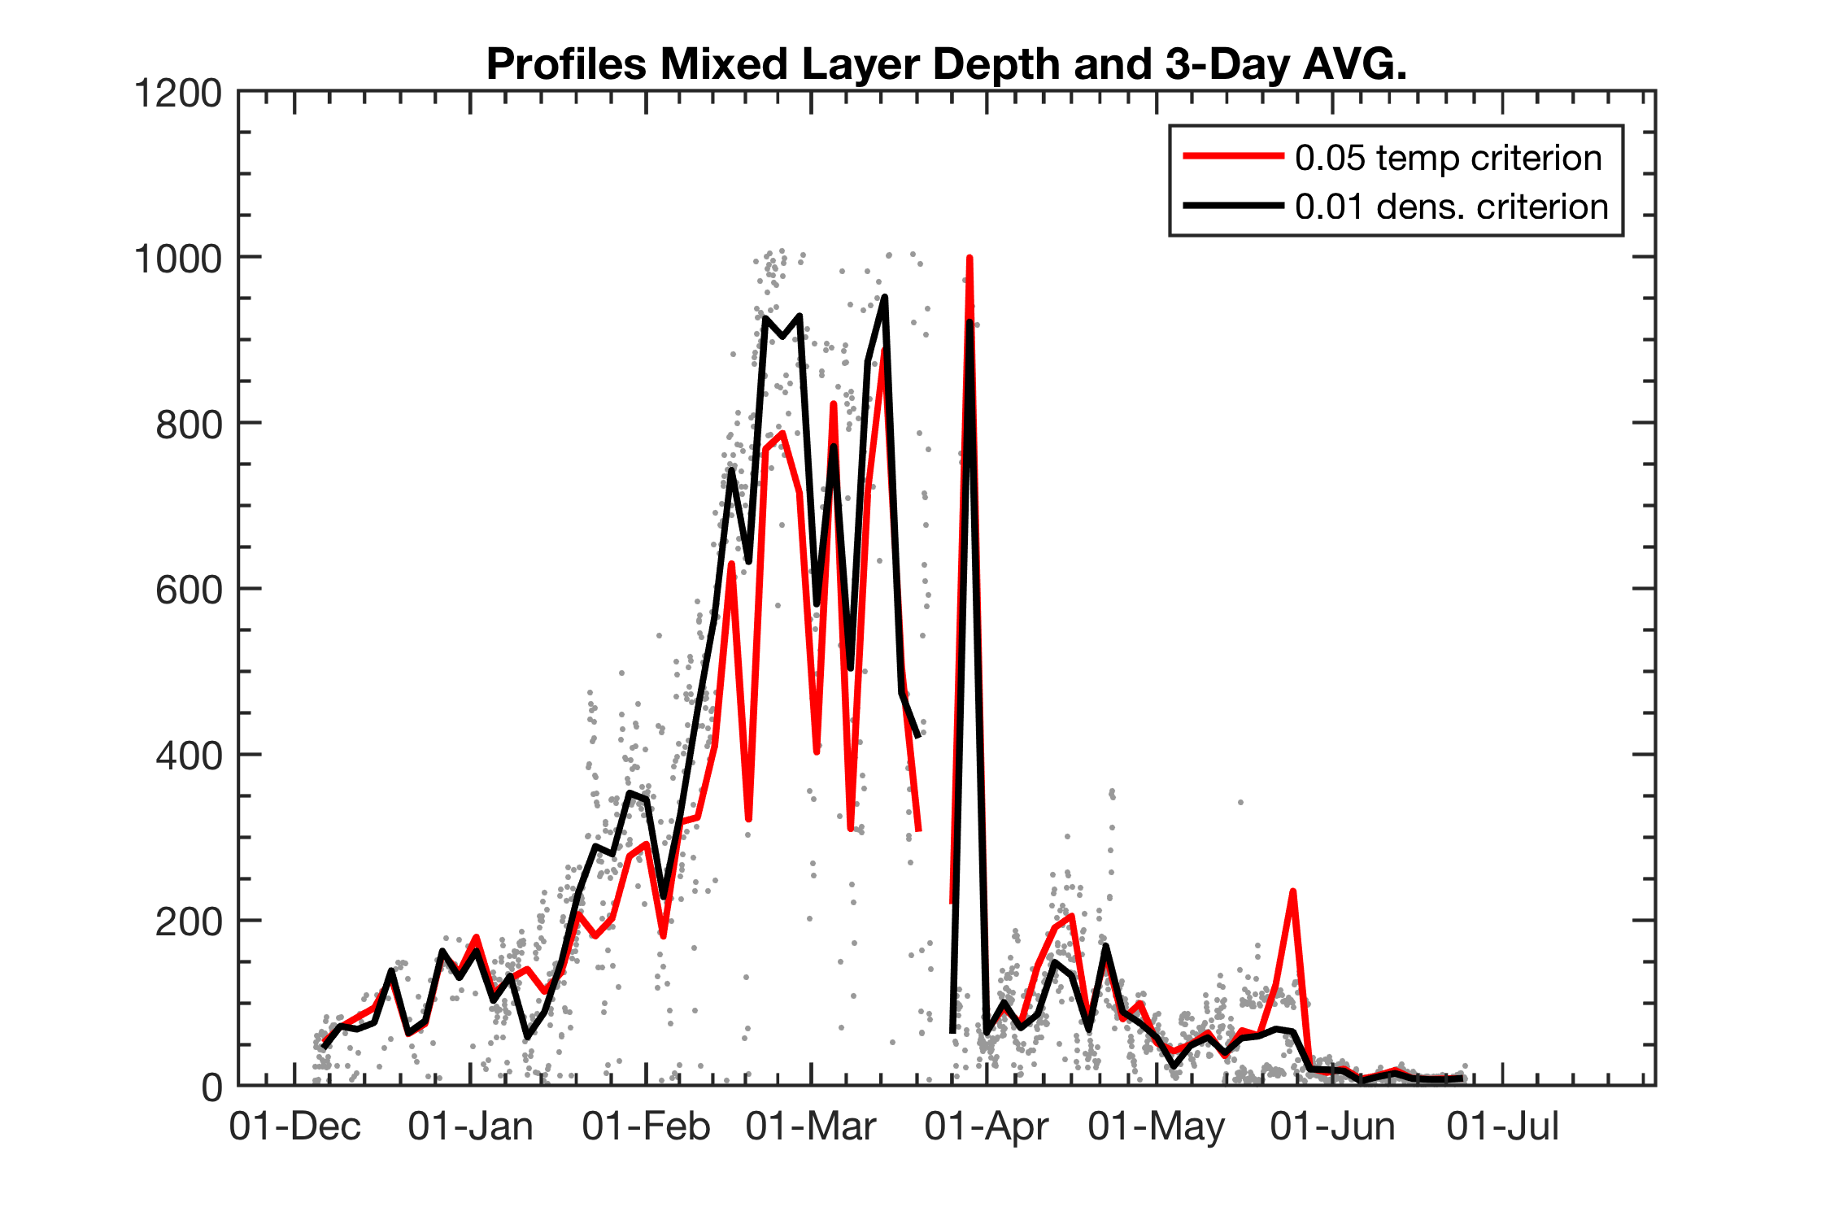
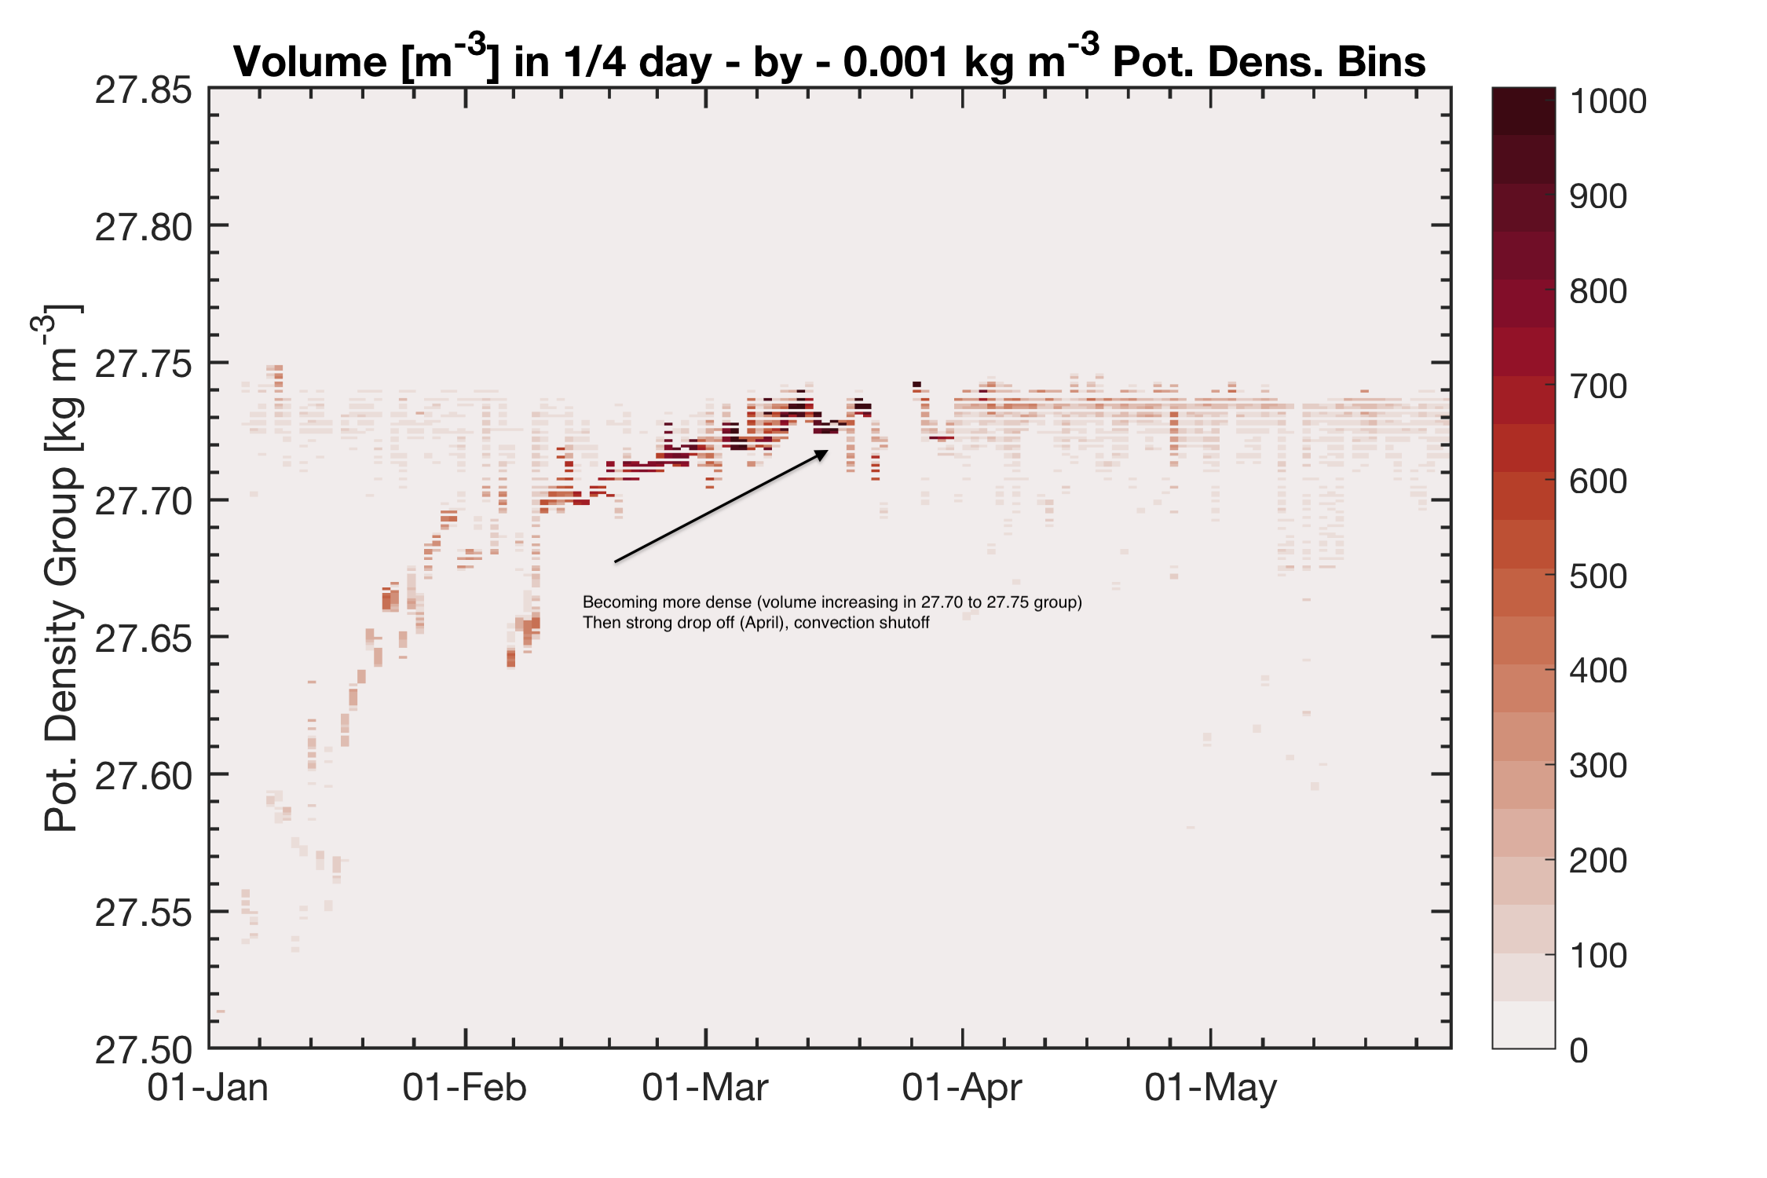
Mixed layer and convective product analysis
Using 2 MLD criterions: Delta T=0.05 C and Delta Sigma = 0.01 kg/m3
Volumetric plot from binning density and calculating the total depth occupied by a density class. The composition of LSW from 2 sources is visible by the merging into LSW during convection in February – March, anomaly in Febr. could be from an eddy.

Slide 11
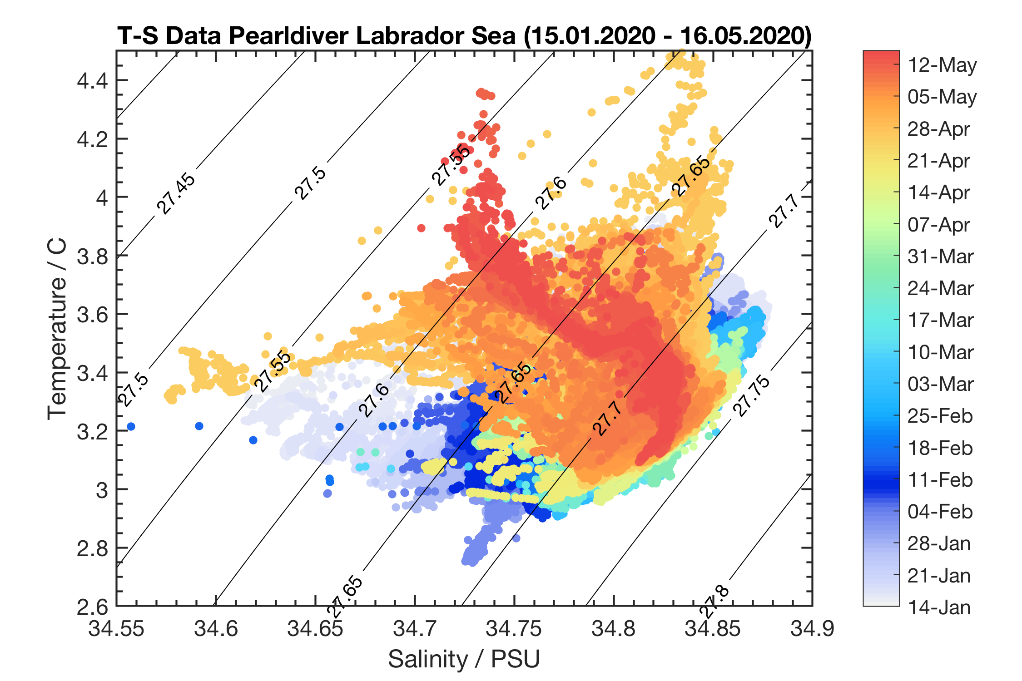
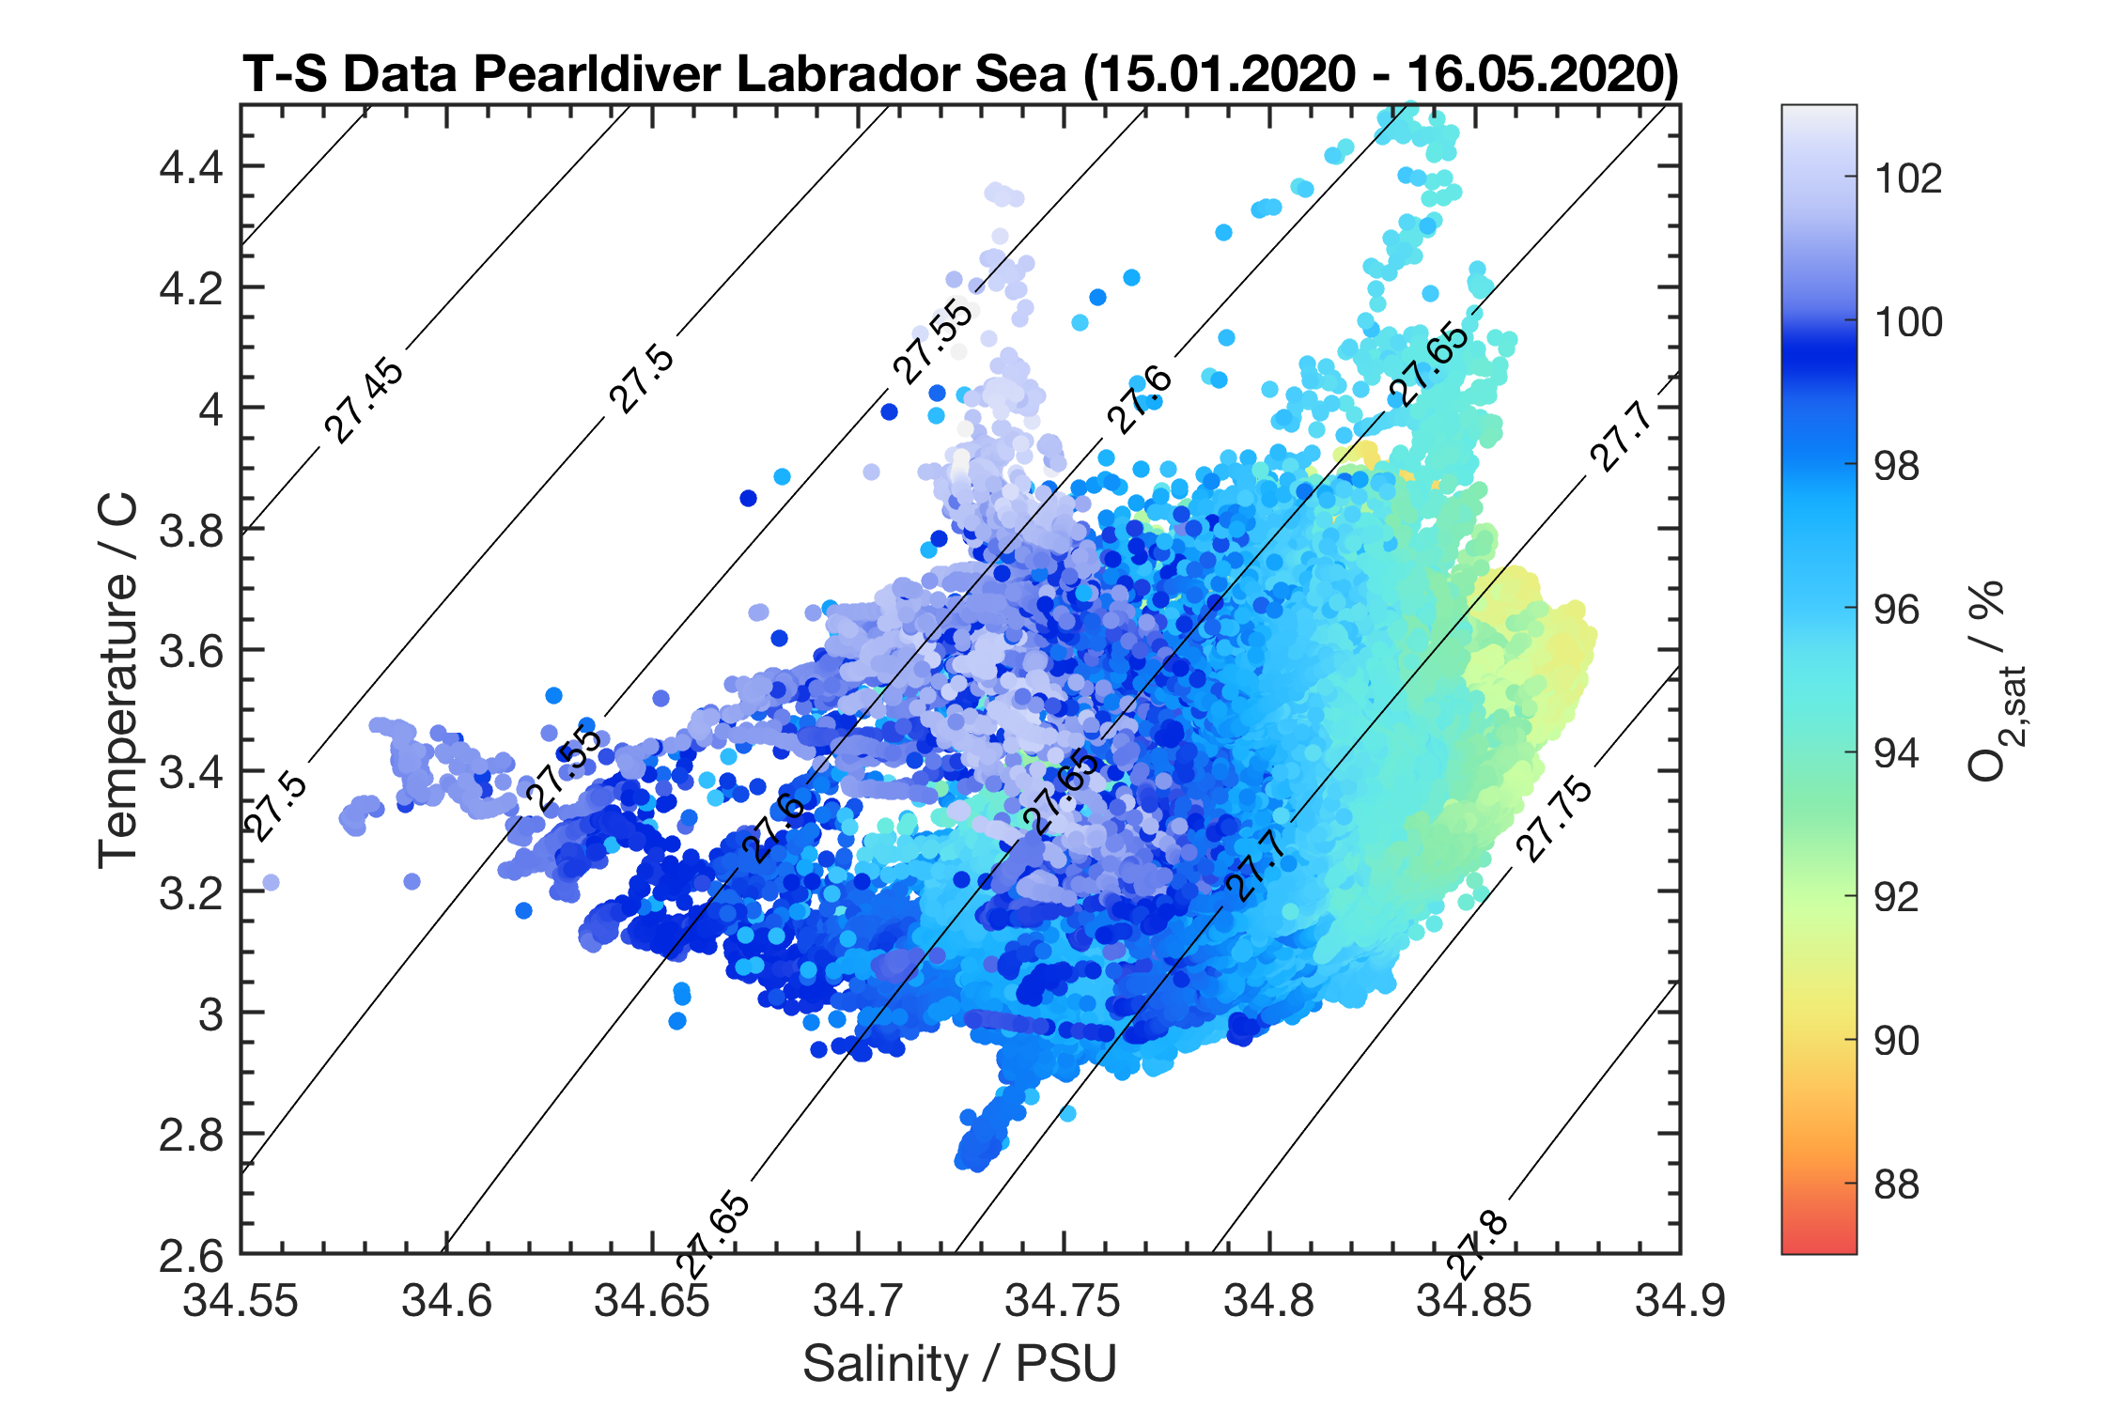
T-S Diagram January 15-May 15, 2020
Water transformation takes place Feb. to 1st of April , Oxygen moves from 100% in winter to 94% end of convection period (outgassing)
Composition of LSW 2020 from 2 sources is clearly visible (one oxygenated from shelf? And one slightly more depleted)
Poss. Eddy Jan later slides

Slide 12
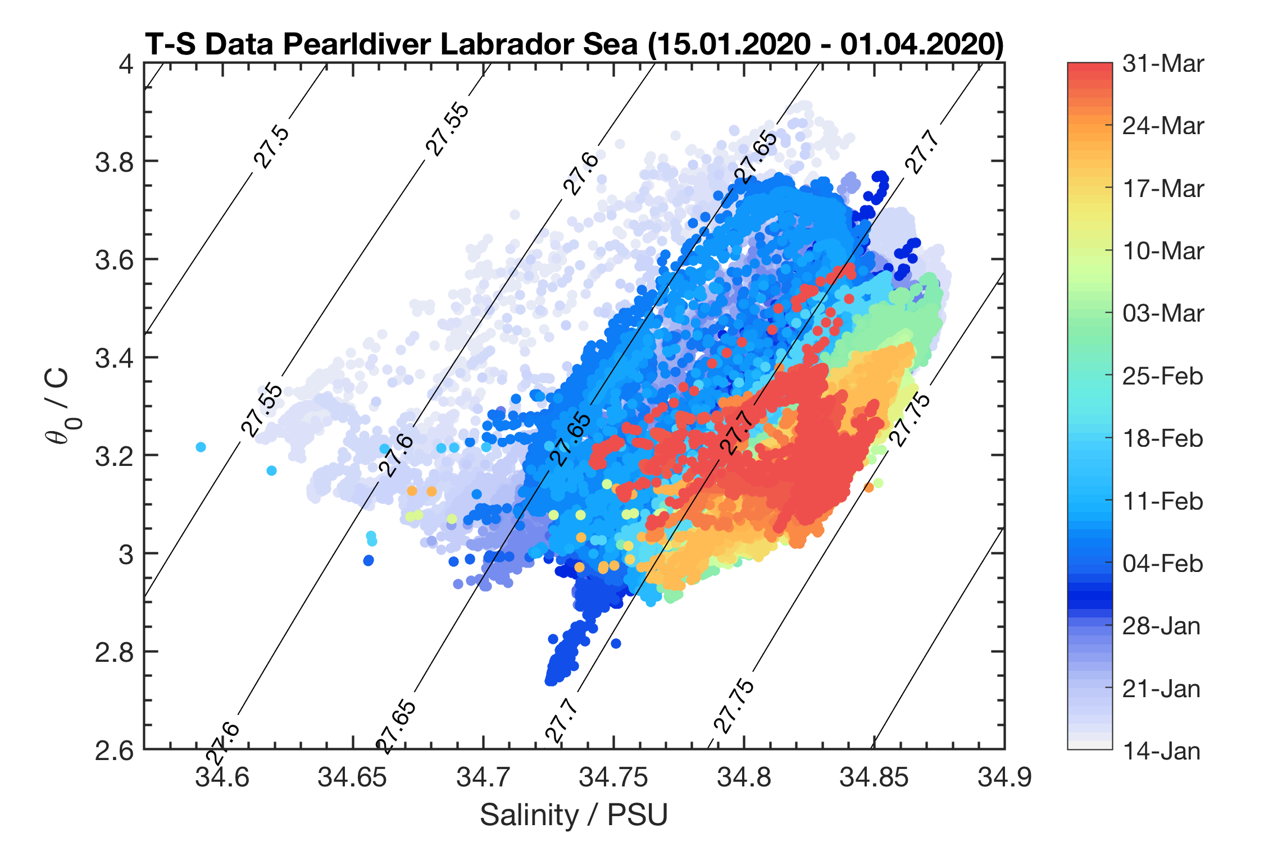
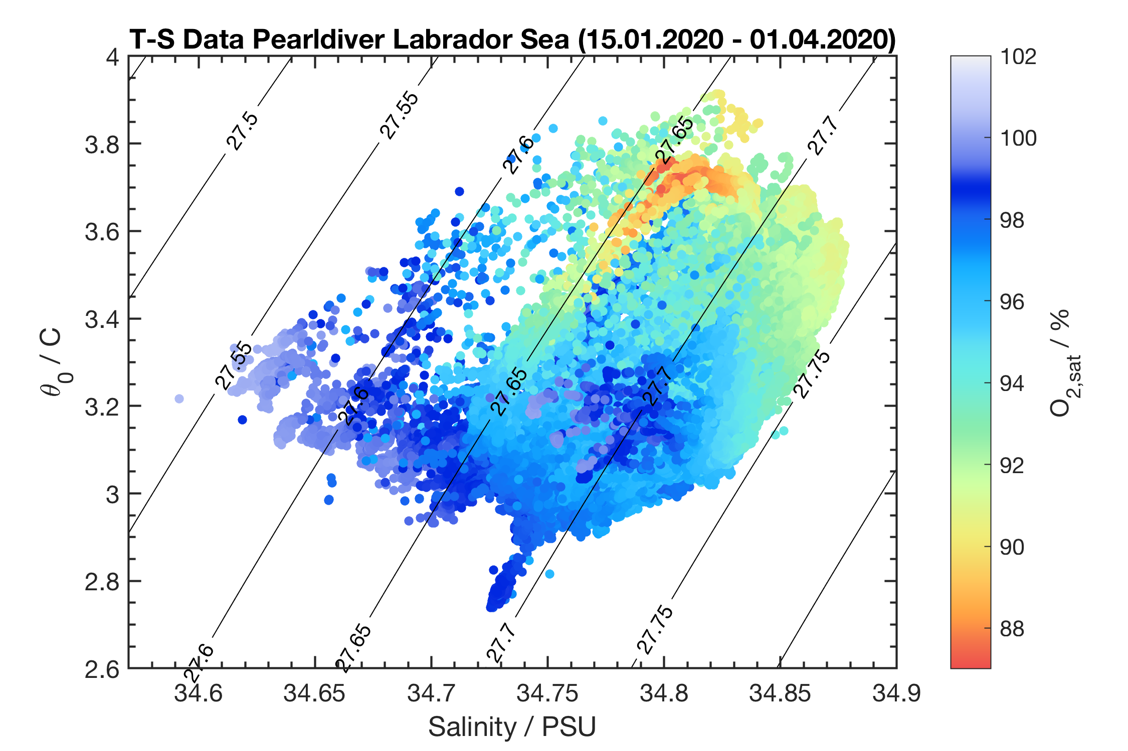
T-S Diagram January 15-May 15, 2020
Same as before but using potential temperature instead of In-situ T
Poss. Eddy Jan later slides

Slide 13
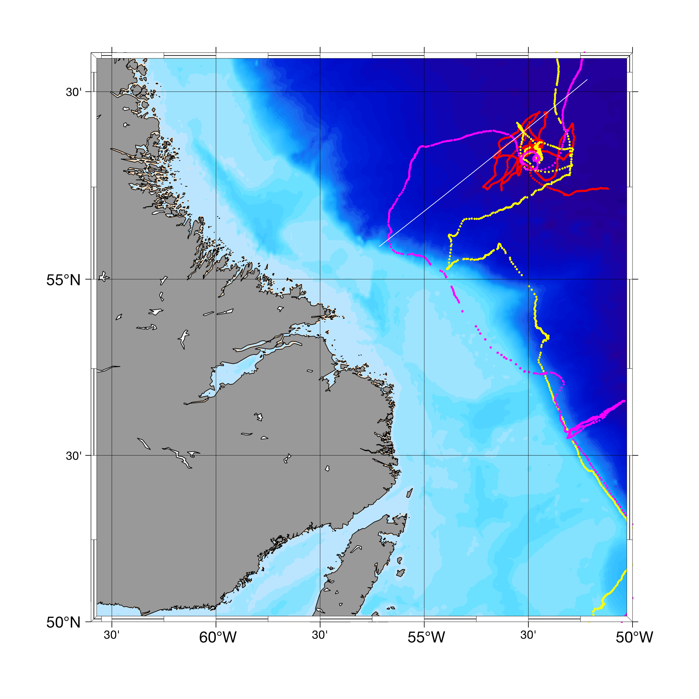
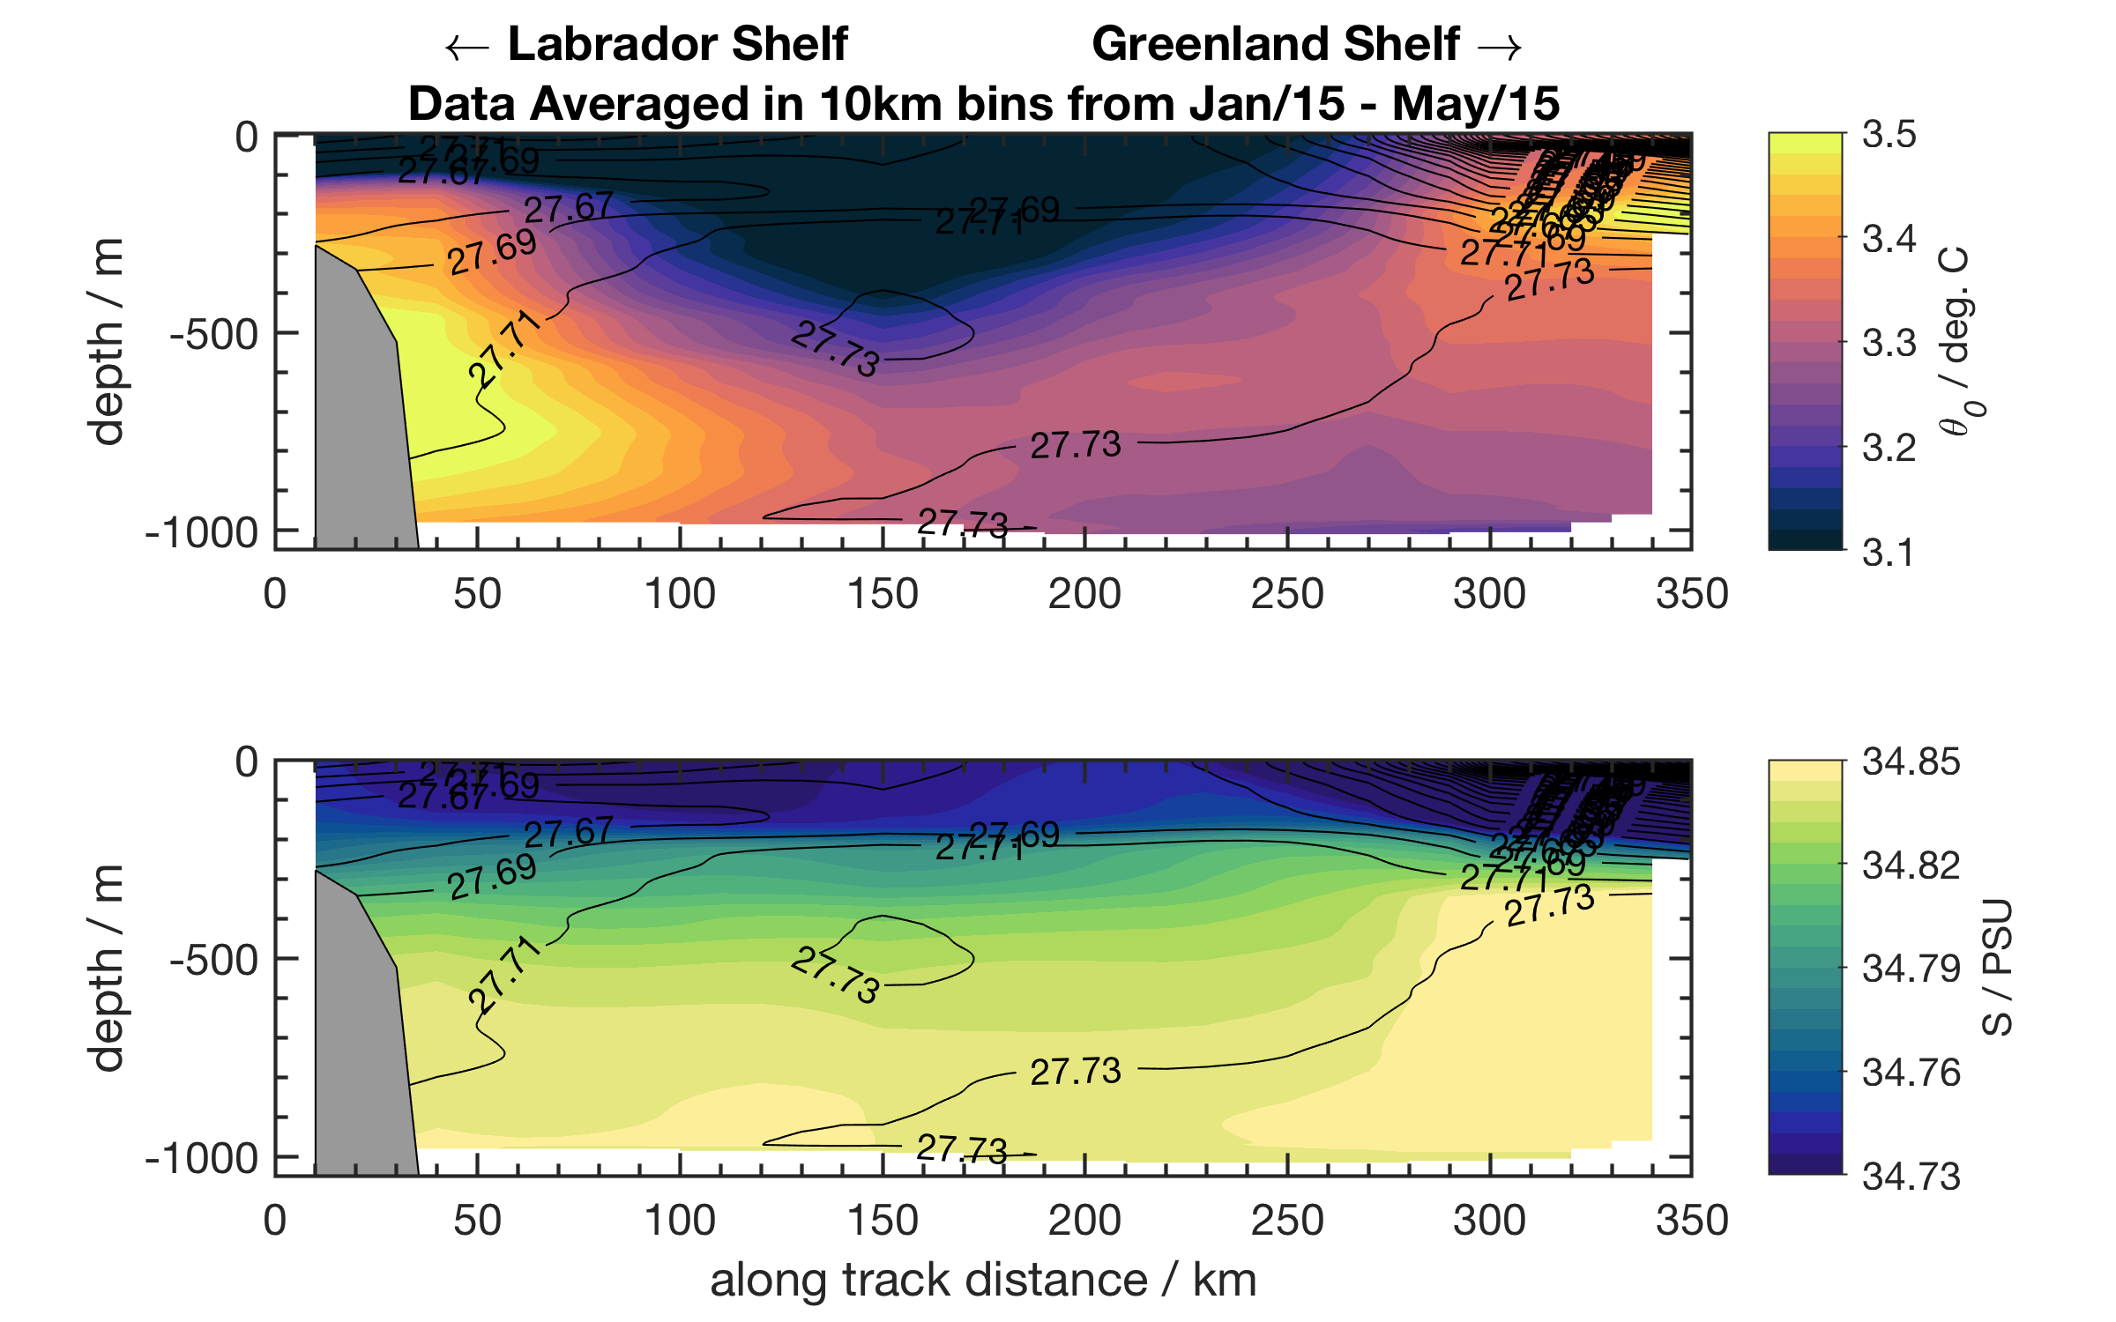
Extract across-shelf section to combine with TERIFIC gliders Scappa and Ziggy

Slide 14
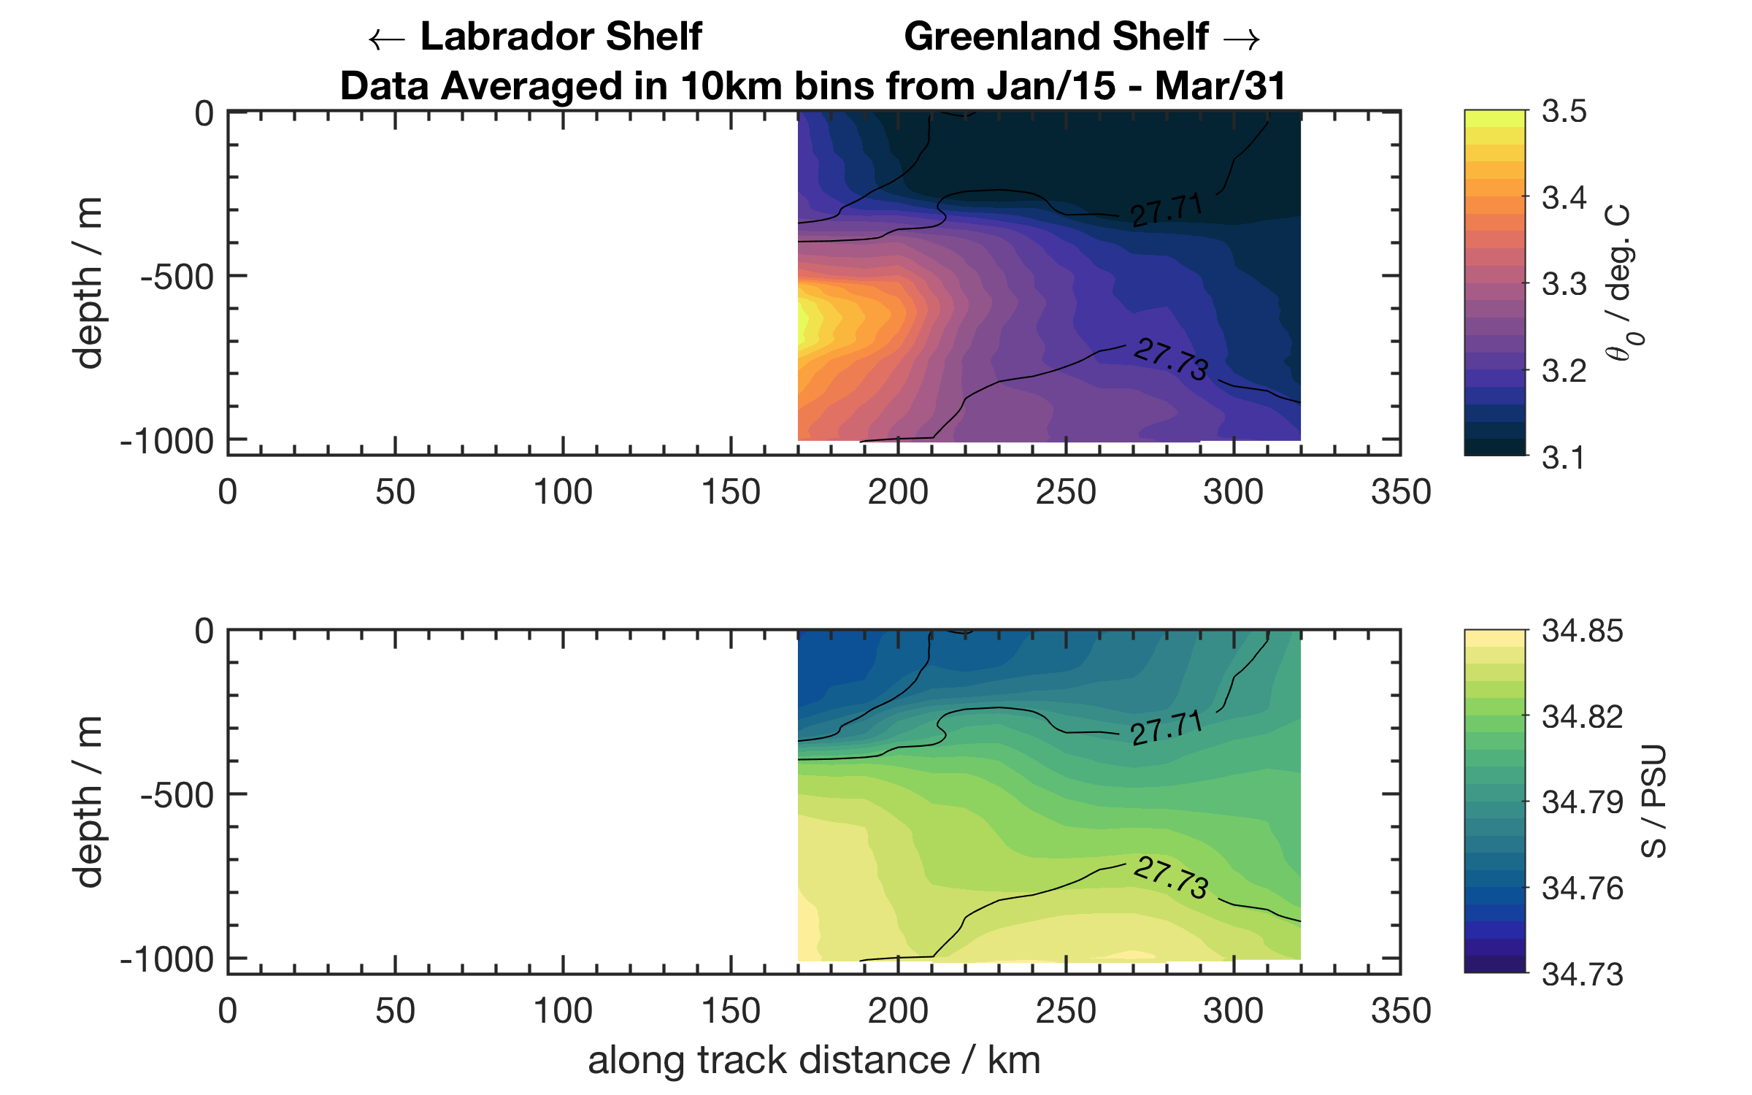
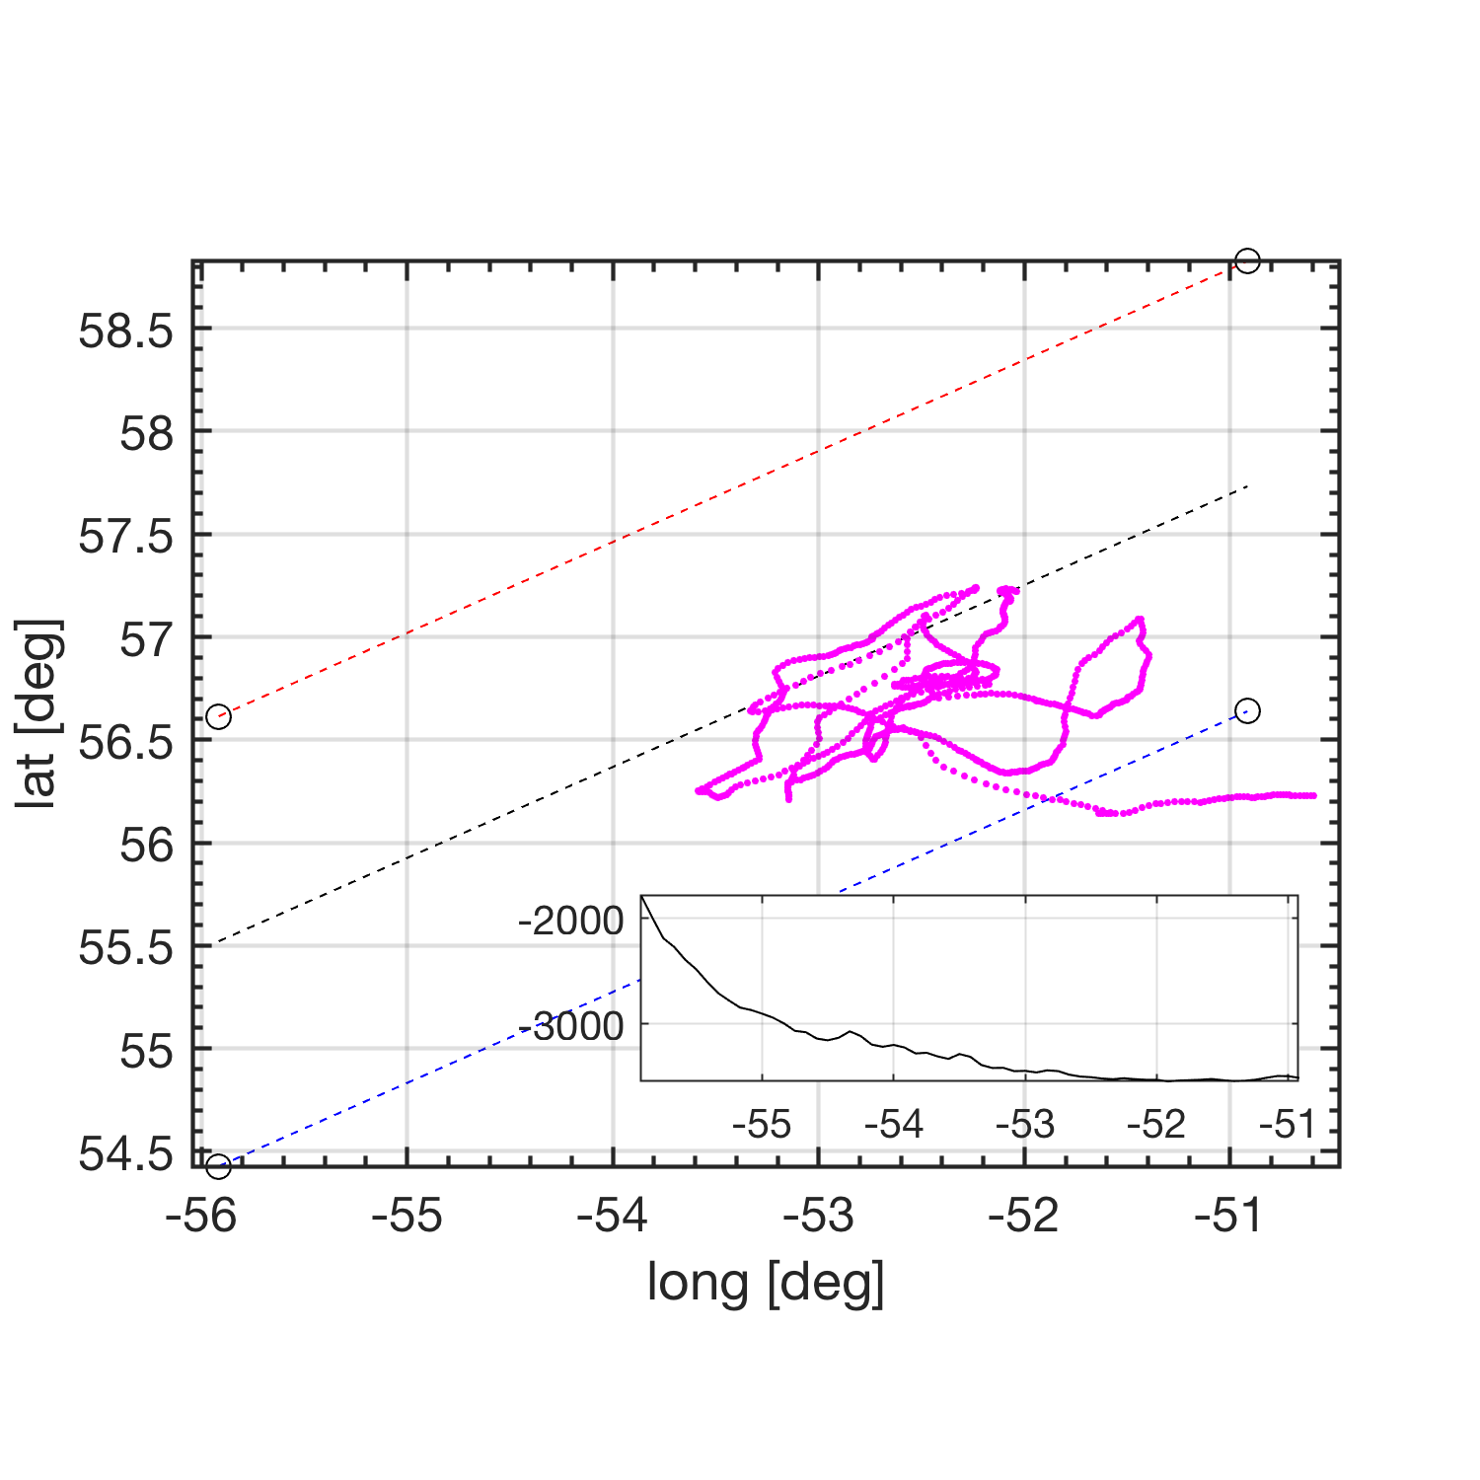
Along track gridding: Pearldiver
Gridding Method:
using 5 m depth, 10 km spatial scale for binning
Calculate spatial gradients for properties maybe

Slide 15
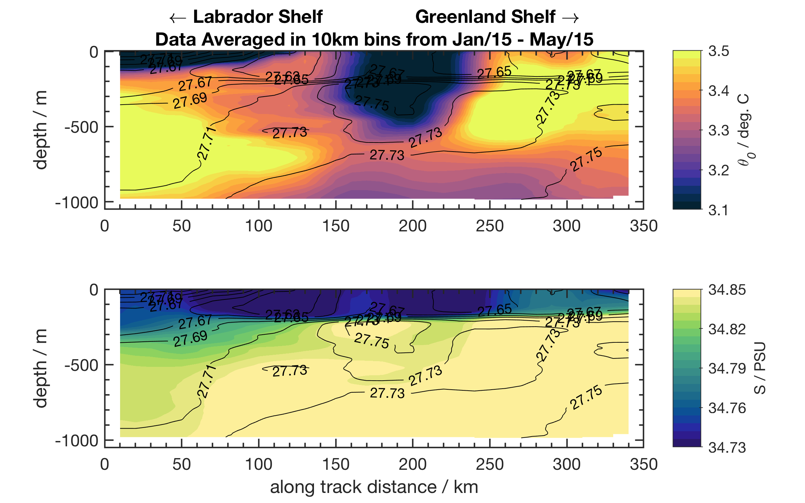
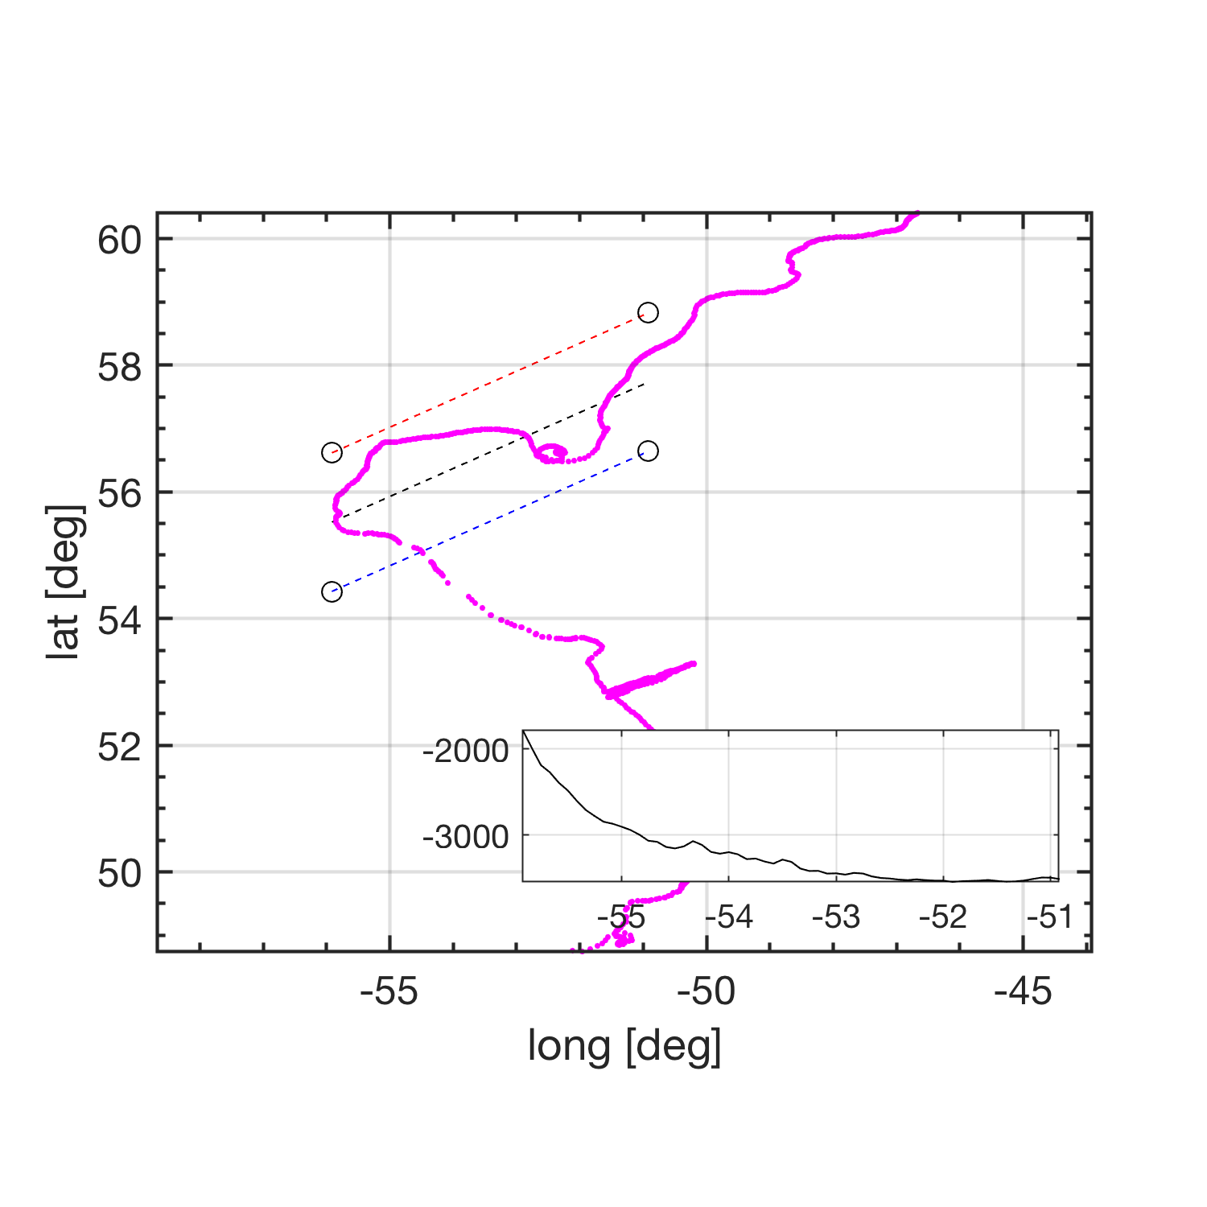
Along track gridding: SG602
Gridding Method:
using 5 m depth, 10 km spatial scale for binning
Calculate spatial gradients for properties maybe

Slide 16
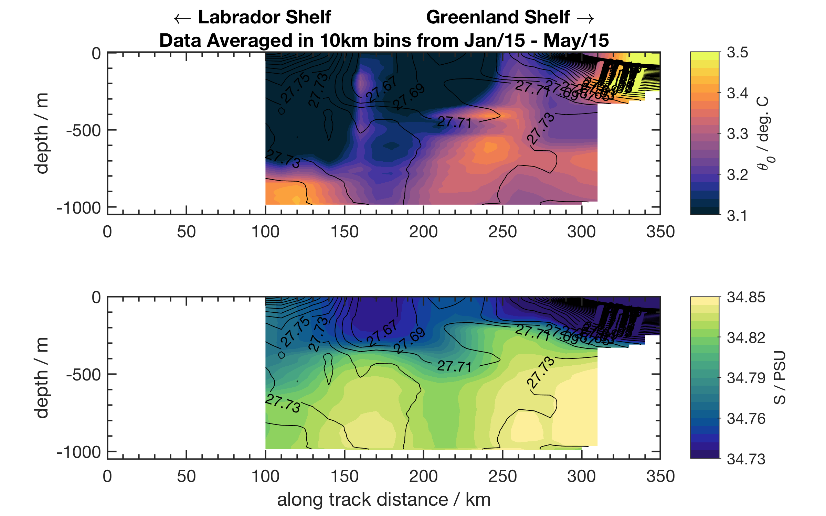
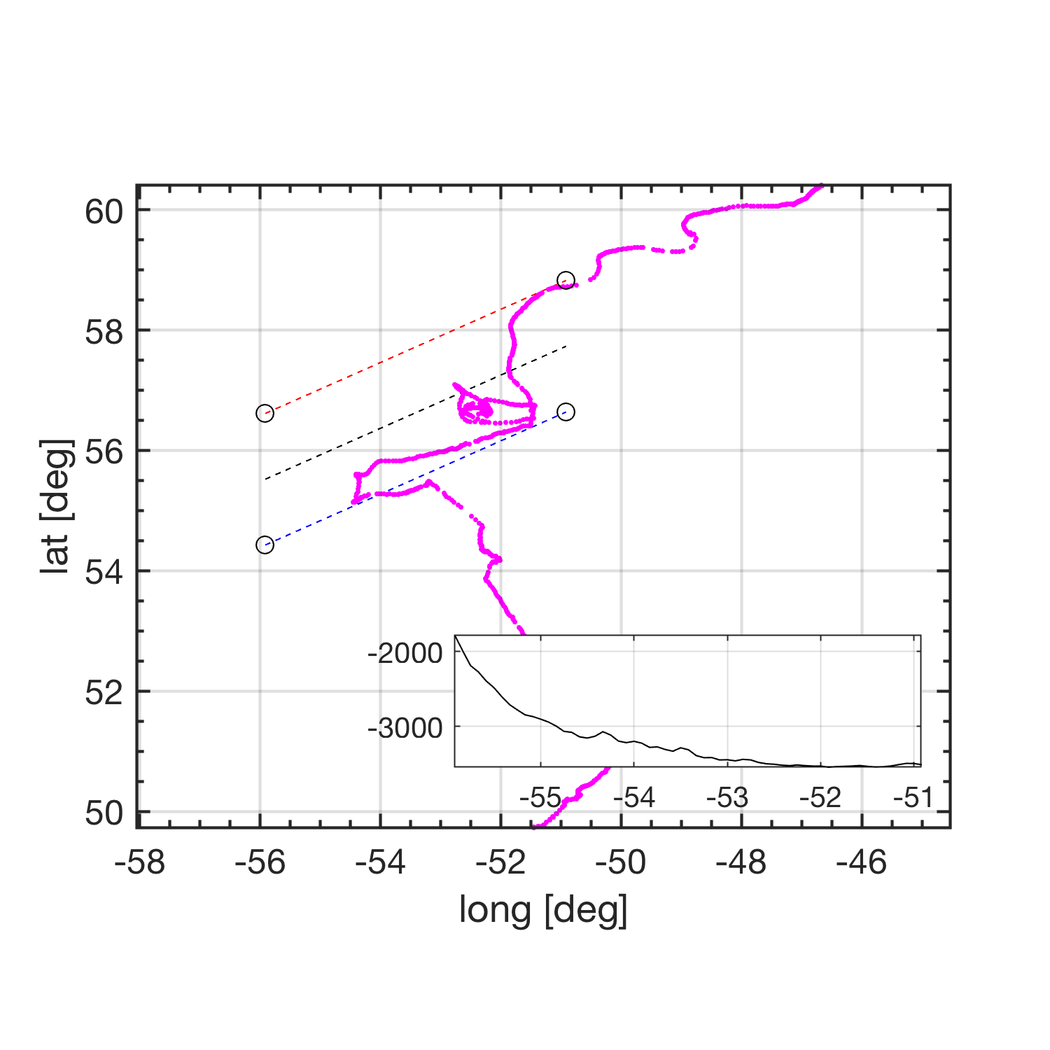
Along track gridding: SG638
Gridding Method:
using 5 m depth, 10 km spatial scale for binning
Calculate spatial gradients for properties maybe

Slide 17
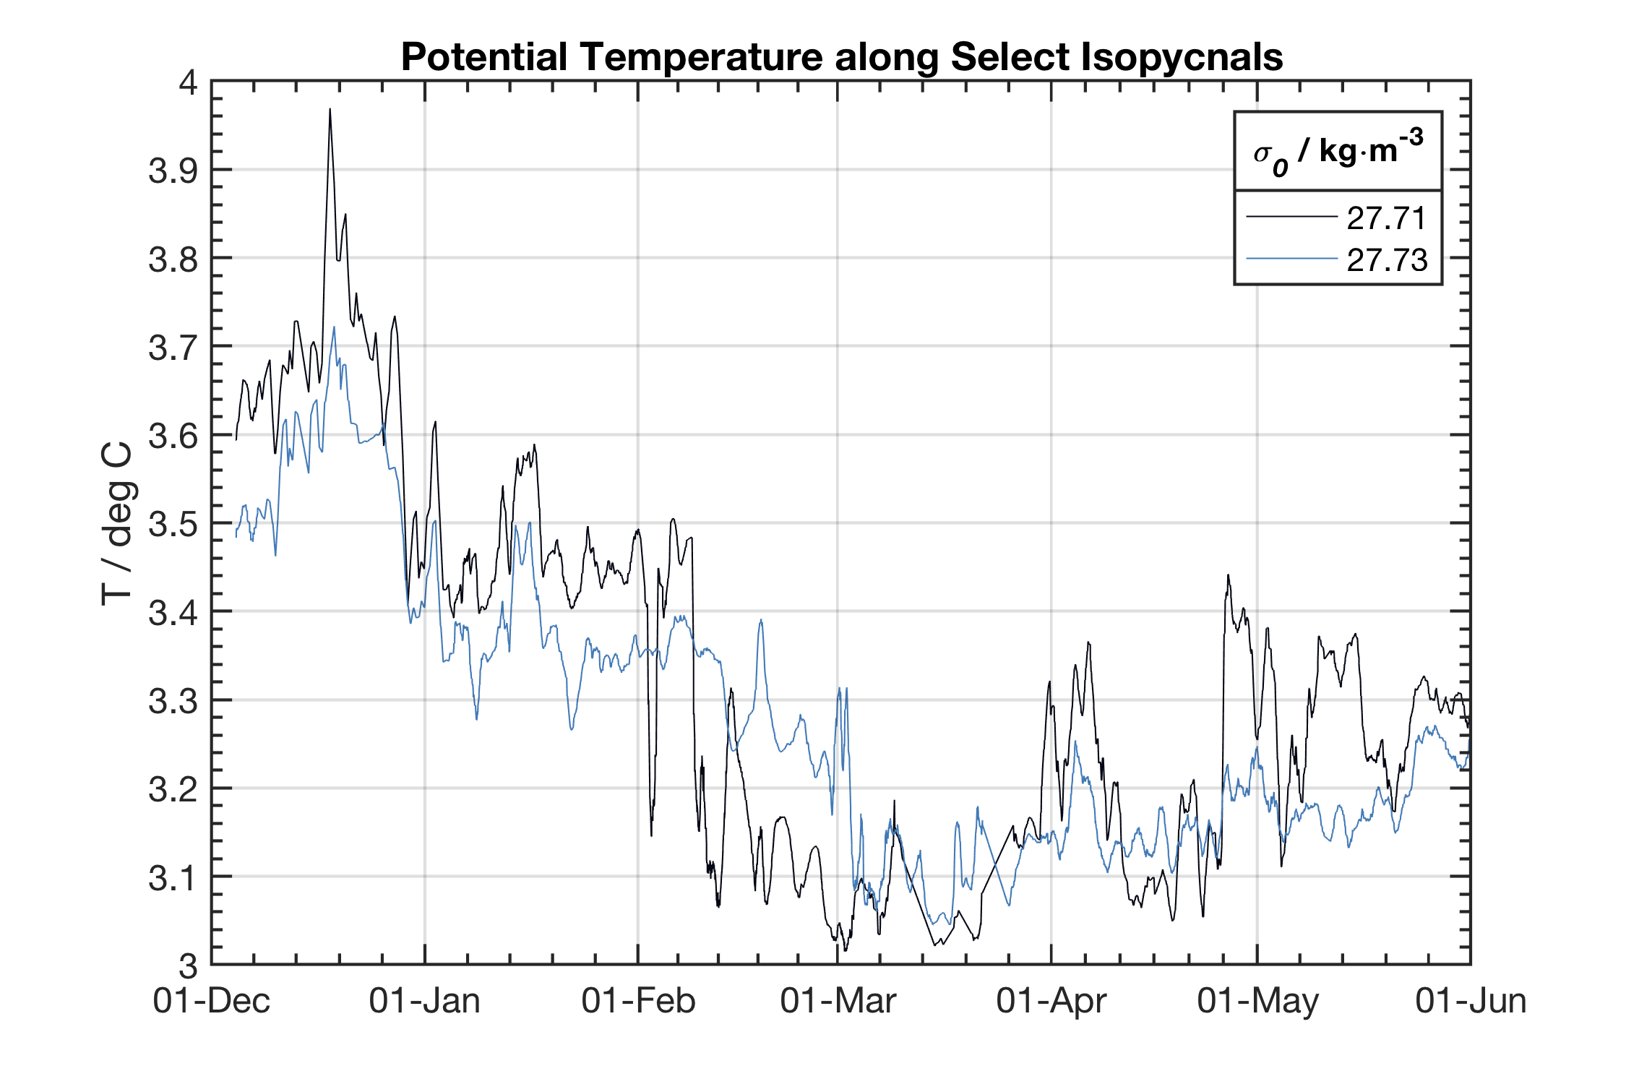
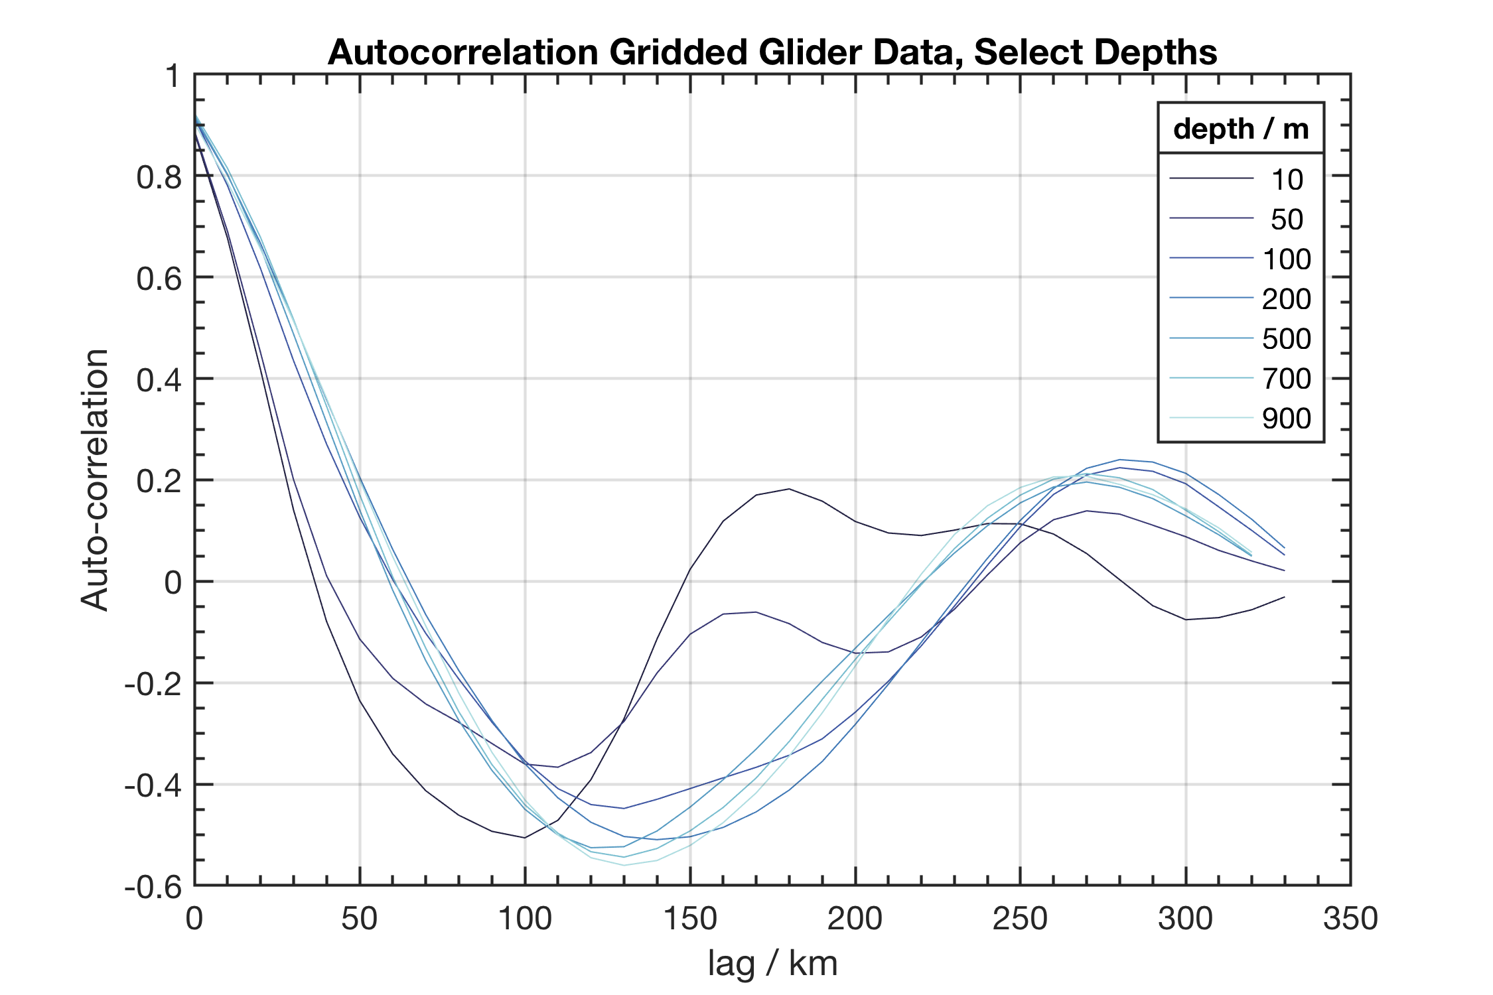
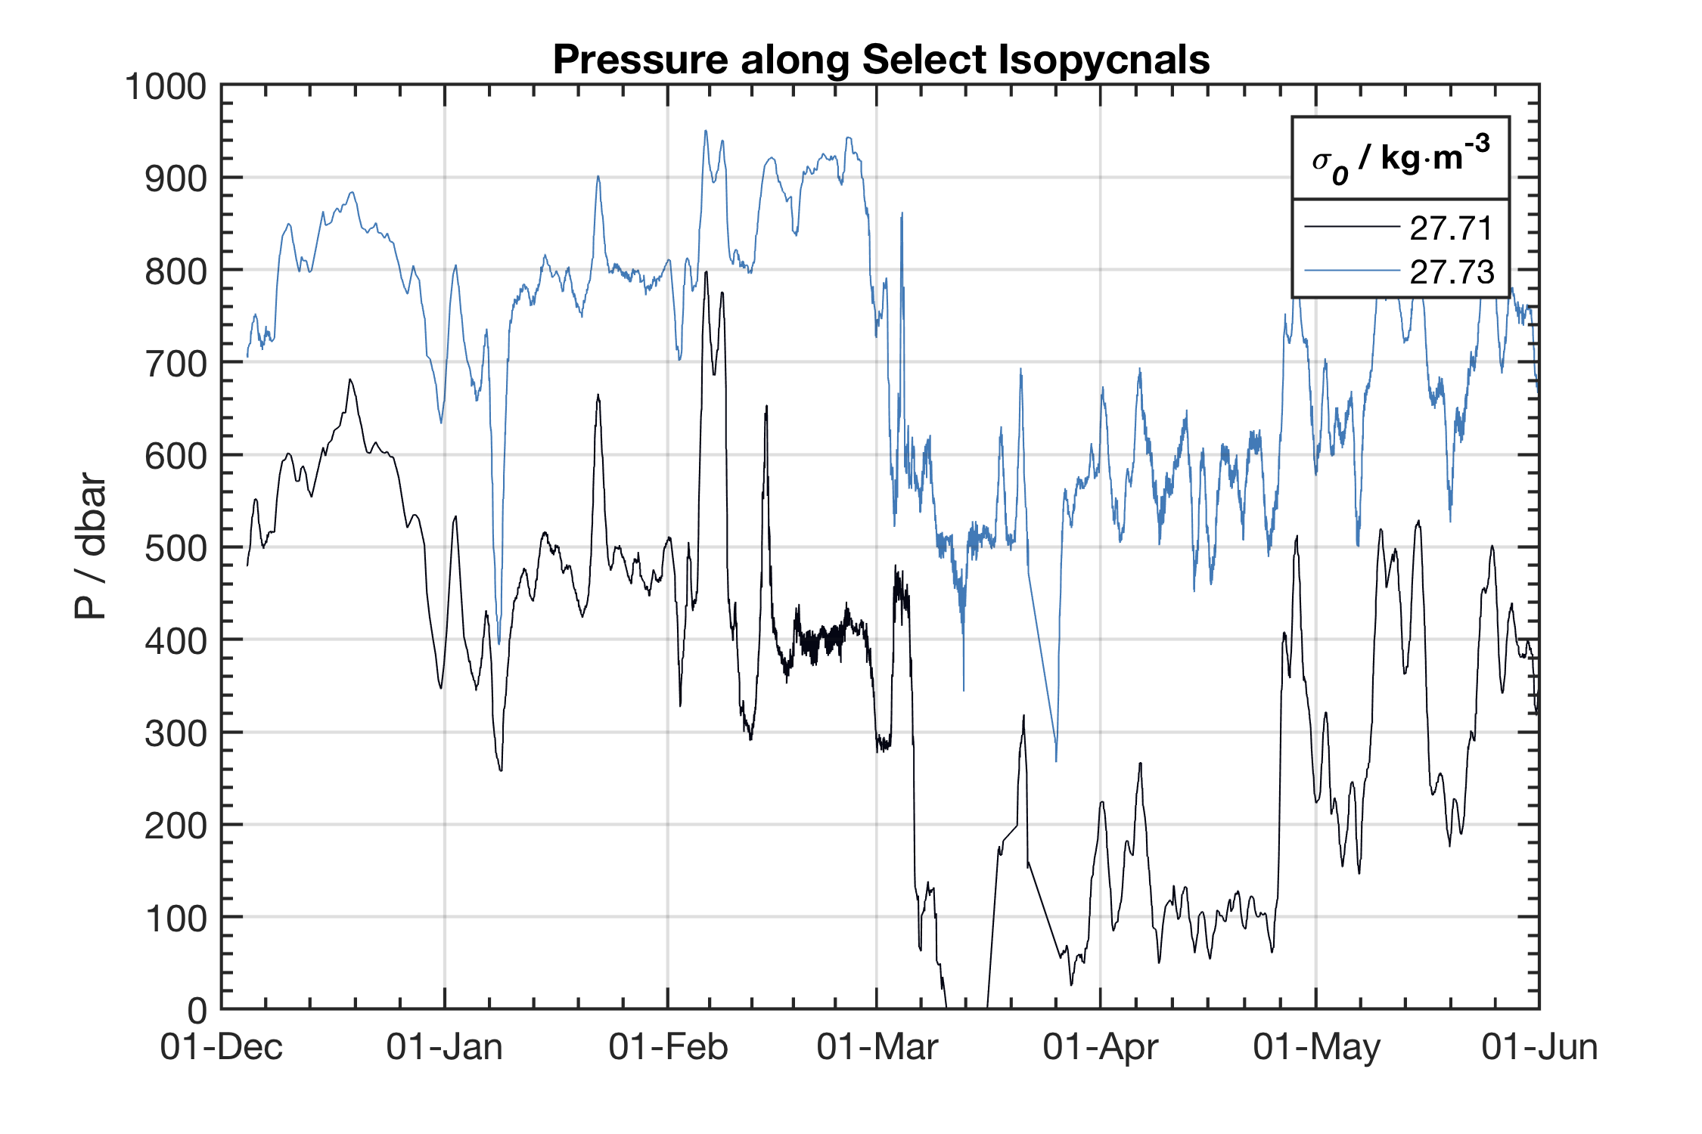
Autocorrelation from Gridded Data

Slide 18
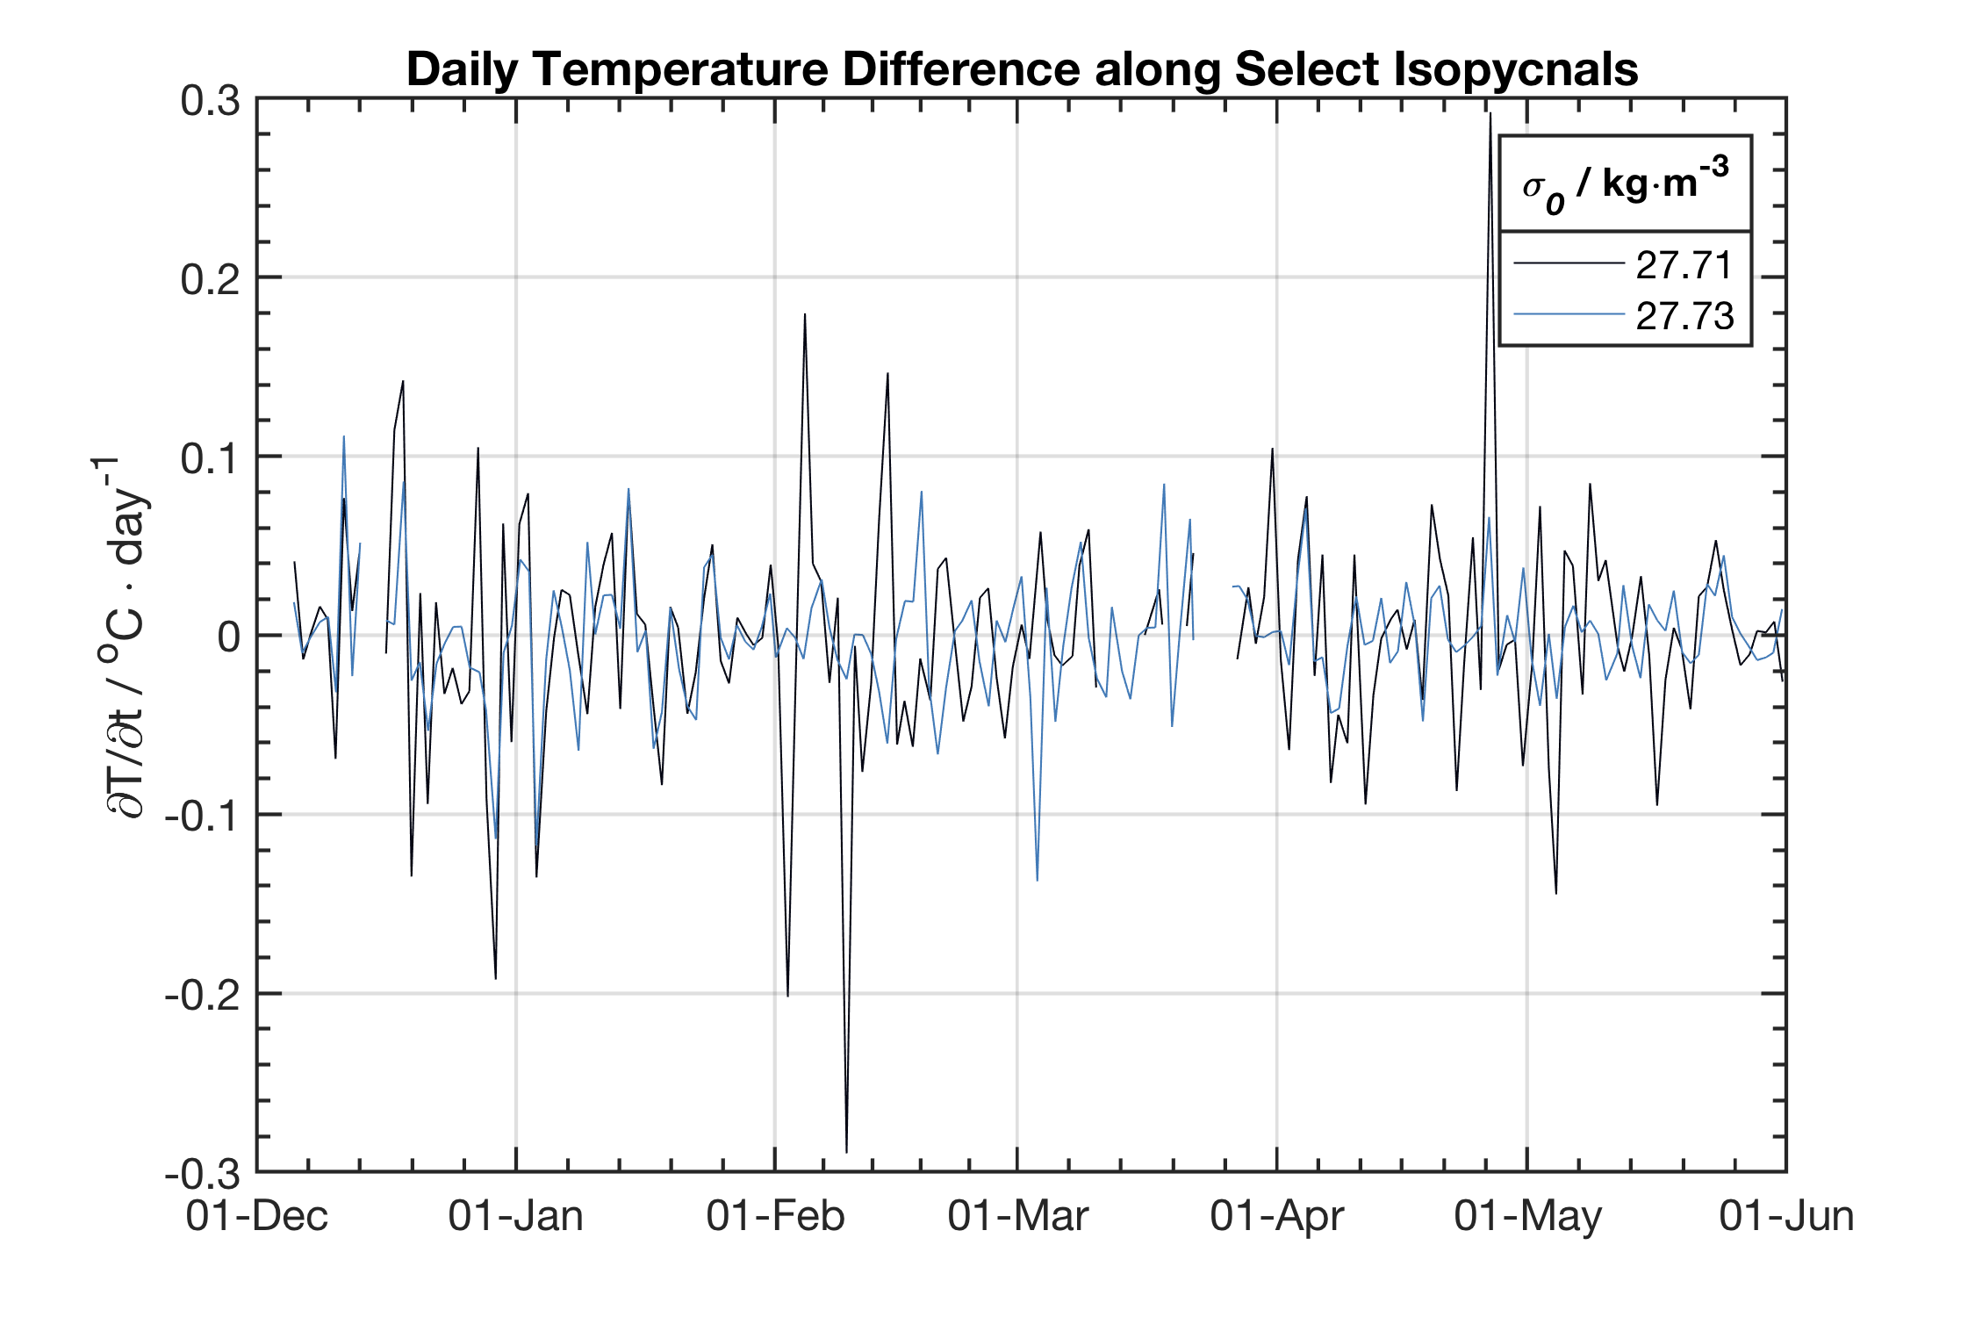
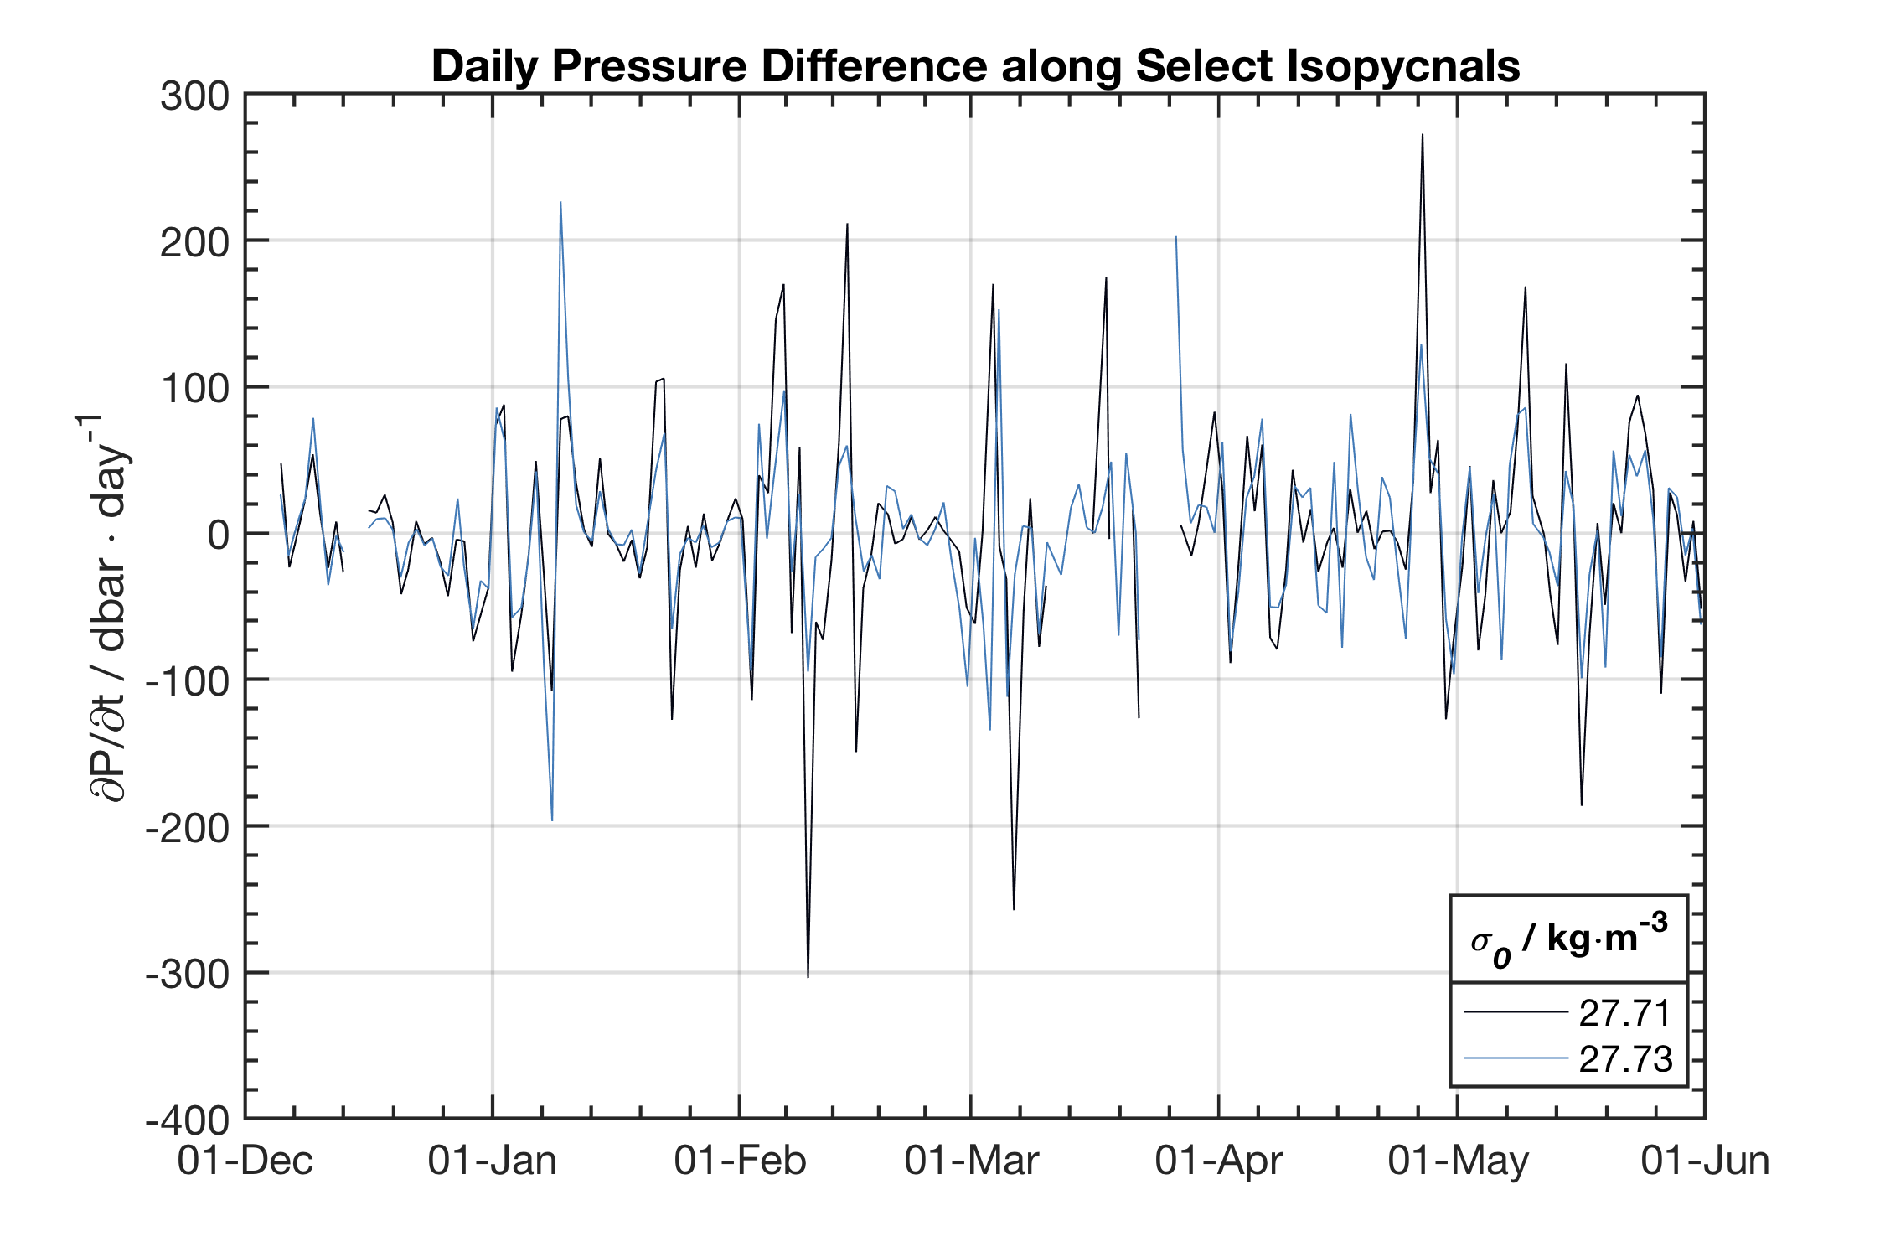
Autocorrelation from Gridded Data

Slide 19
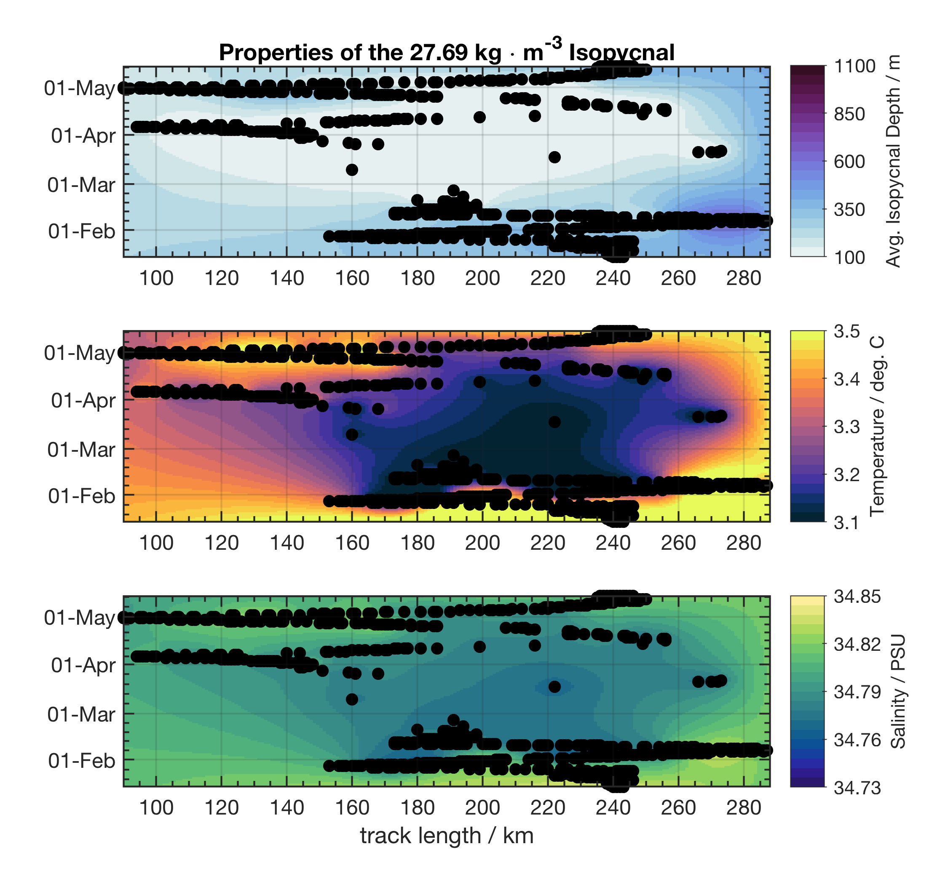
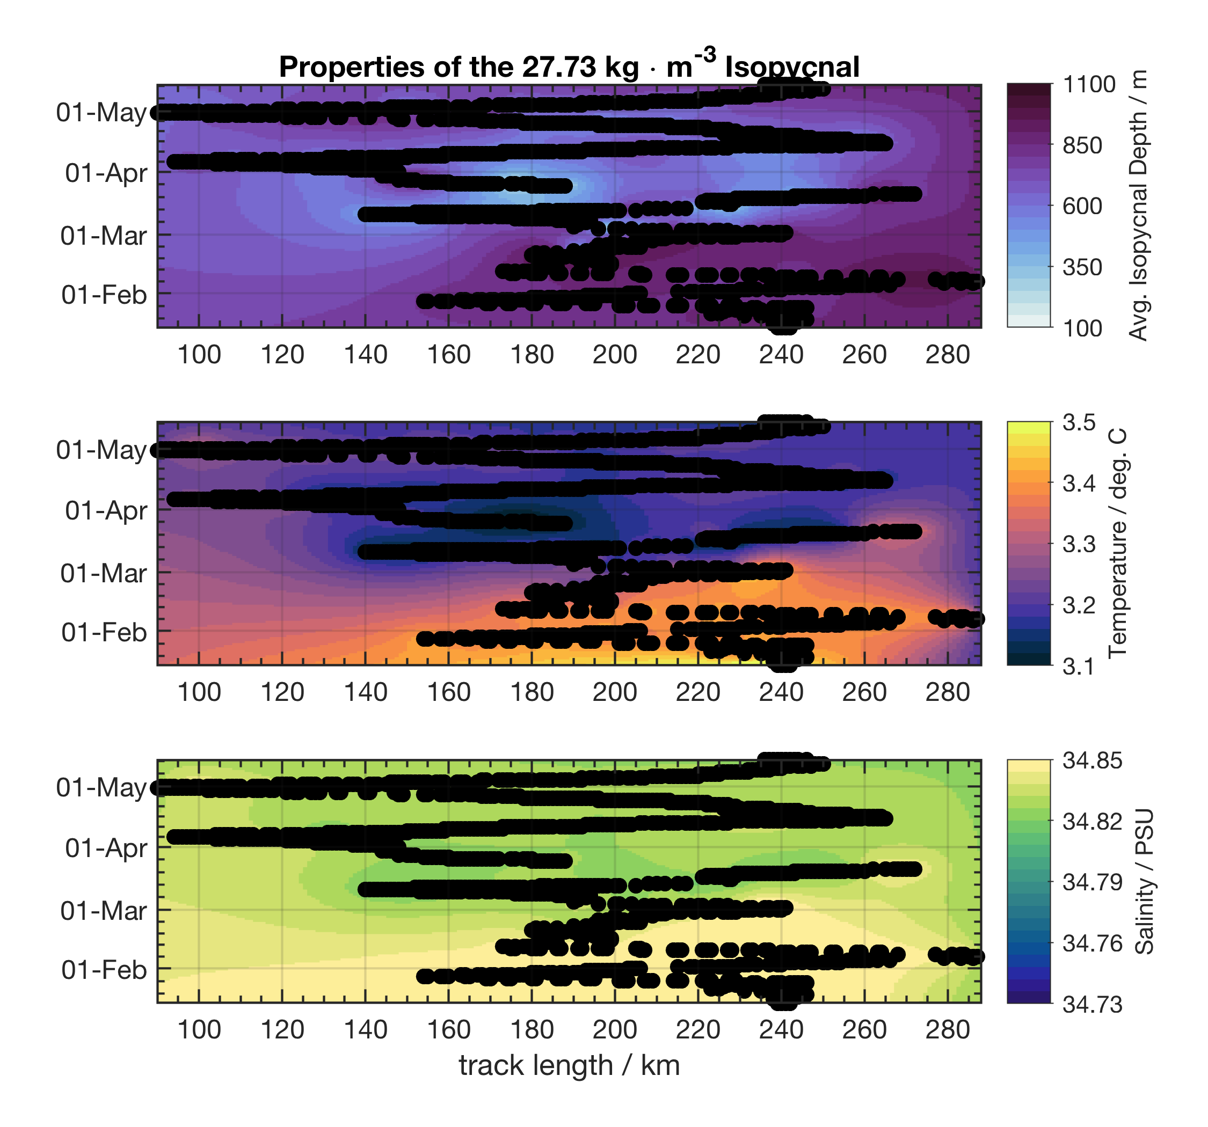
Hovmüller gridding
1 Day by 10 km Spatial Scale (track same as before)

Slide 20
Conclusions Spatial Structure Glider Data
Minimum time latency is 1 month from Pearldiver observations or a about 1 single pass for the Seagliders
Spatial correlation based on (zero crossing) the averaged glider section data is around 50 km with smaller surface scales (35-40 km) and larger subsurface scales (50-65 km) which agree well with SST correlation scales (35 km) from Satellites such as the NESDIS or JPL-MUR41 products

Slide 21
Convection Resistance (buoyancy fluxes)

Slide 22
Methods
Eddy Analysis
Identification: by manual inspection in the profiles looking for isopycnal, temperature and salinity anomaly
Tentatively identified 4 events. Shown are events 1 and 4.
Methods for fluxes from Hátún et al. (2007) adapted for buoyant eddies in a convected (mixed) Labrador Sea basin.
Chosen reference values: mean for the convective period
T = 3.17 deg. C
S = 34.81 PSU
Ref. Rho = 1027.71 kg / m^3
Ref. Radius = 300 km (Lilly et al., 2003)

Slide 23
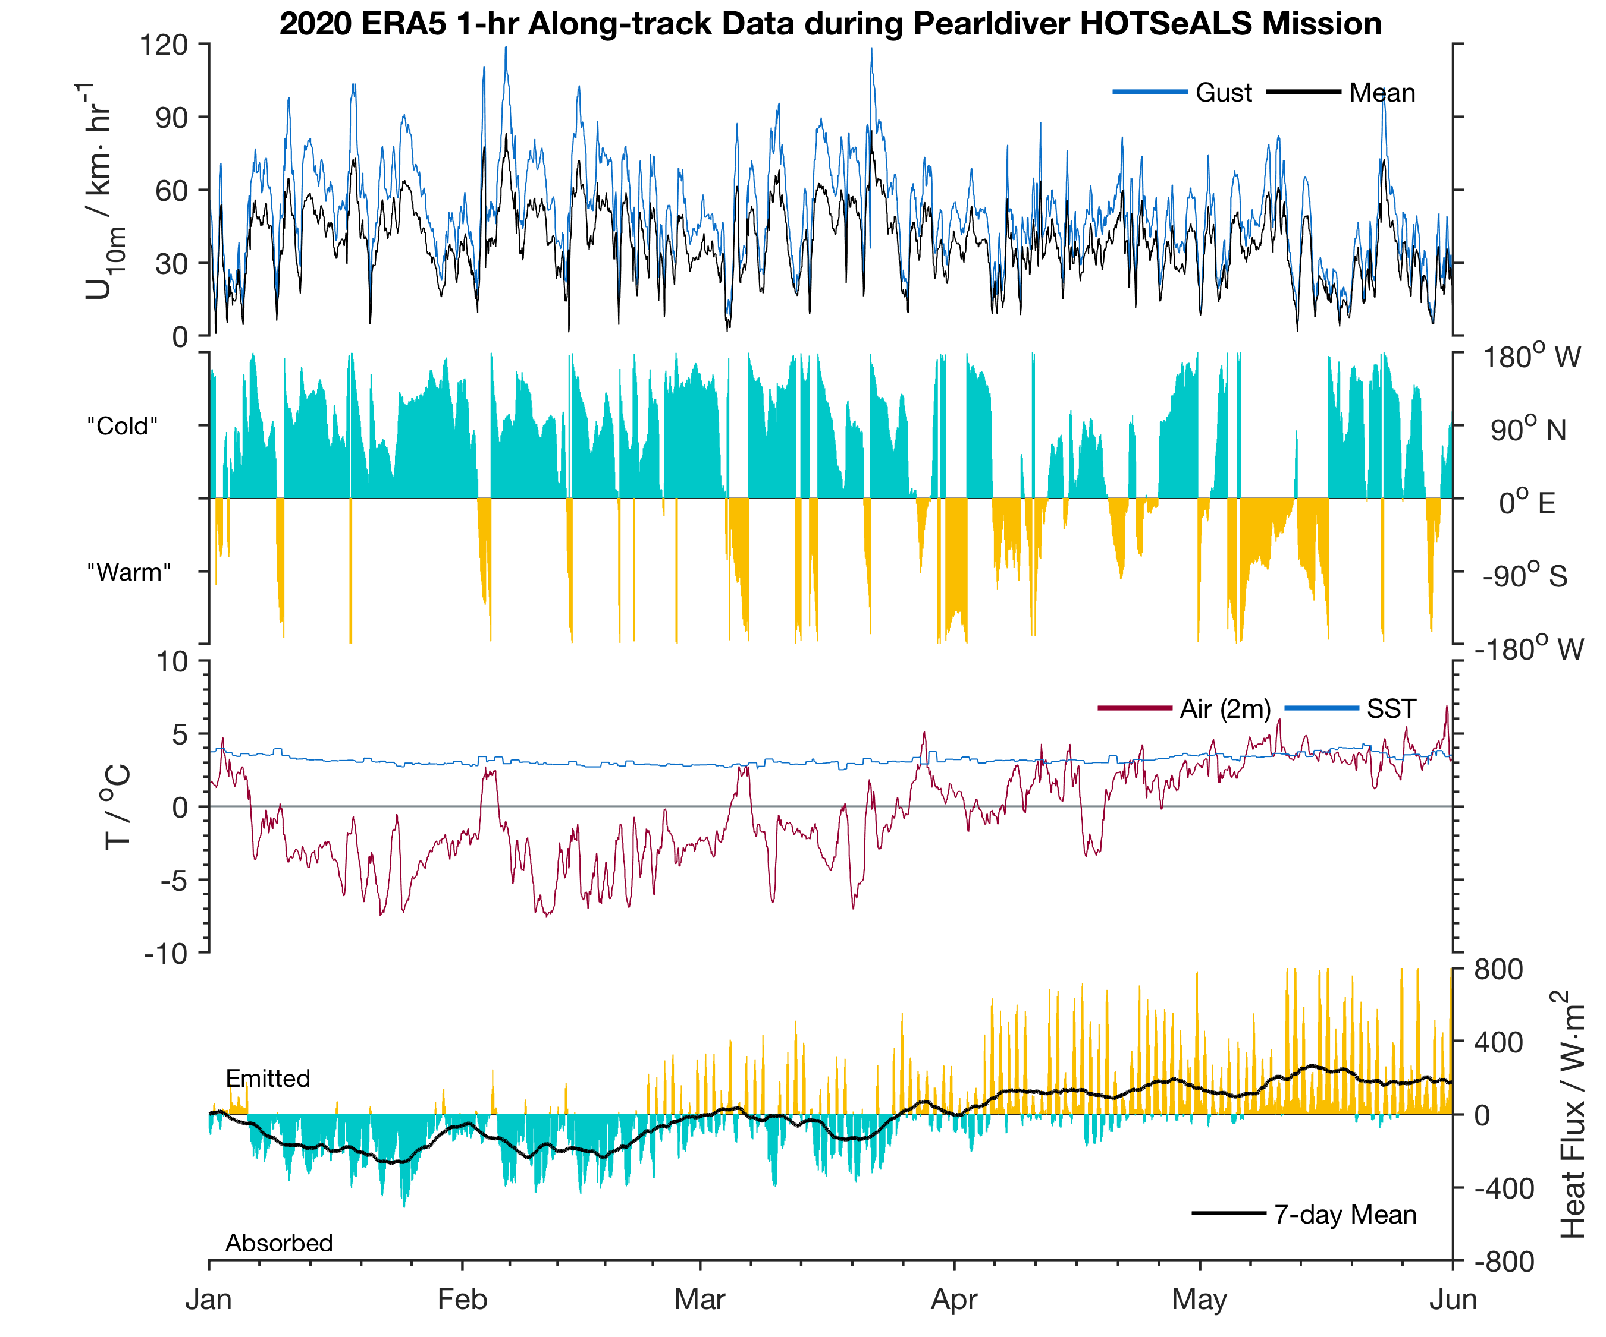
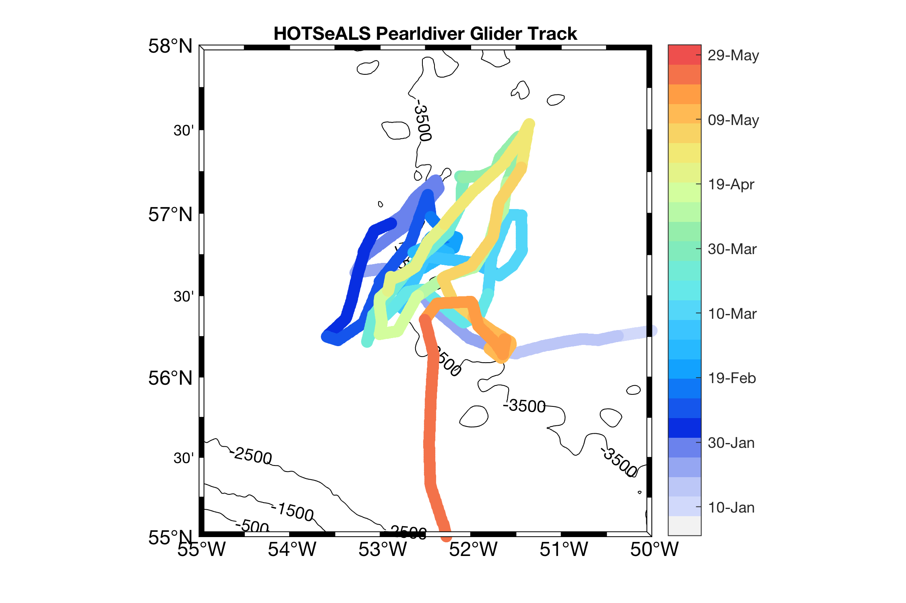
Heat Fluxes from ERA5 Product

Slide 24
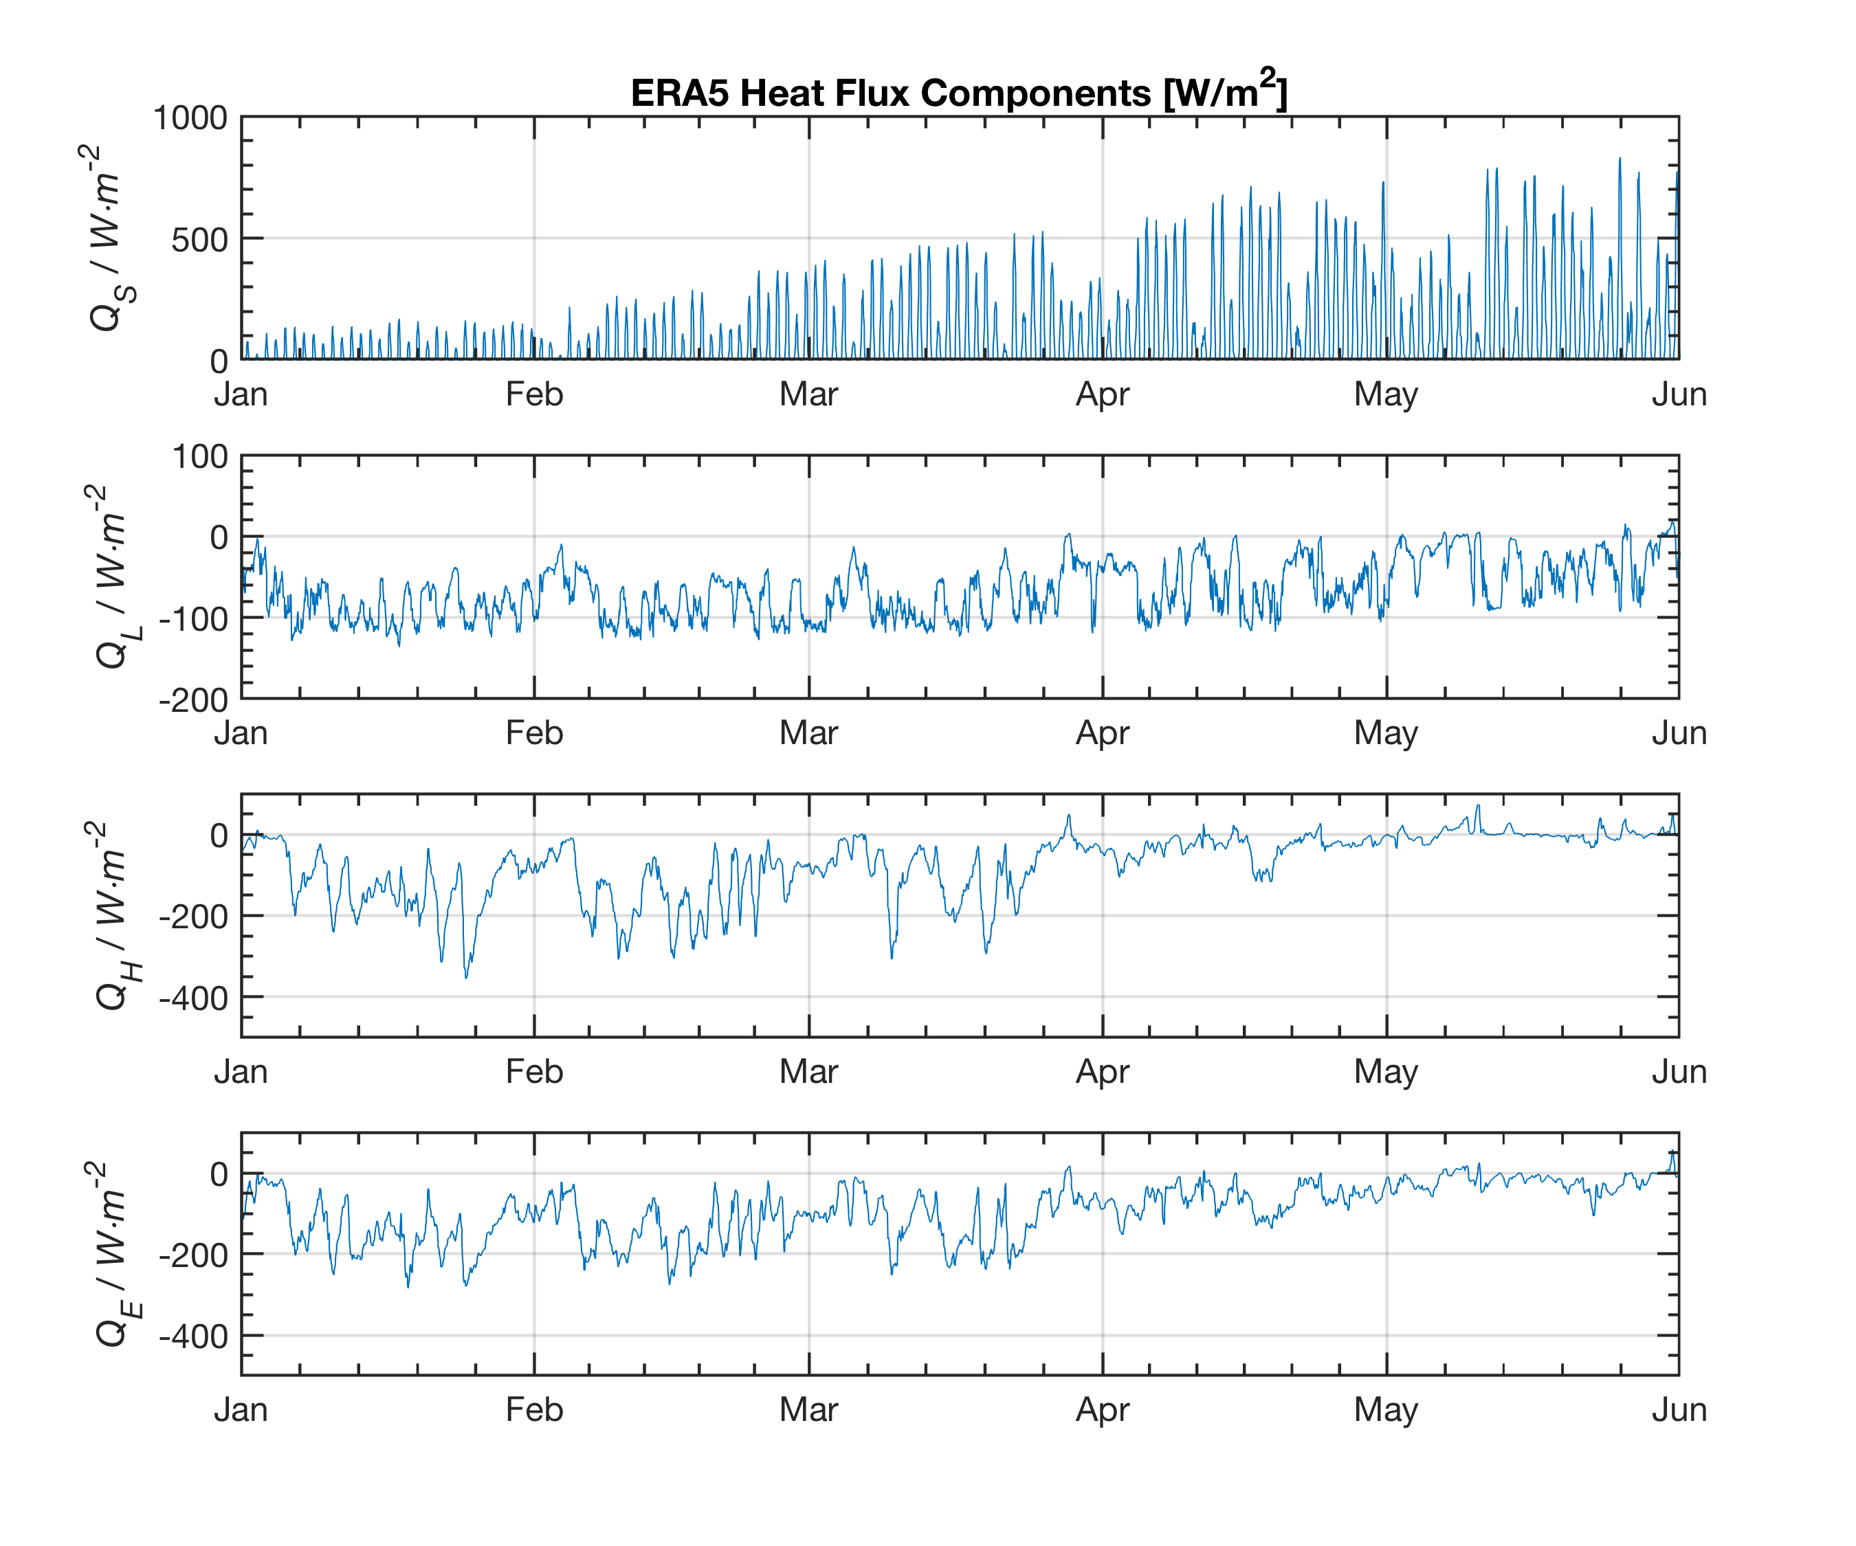
Heat Fluxes from ERA5 Product

Slide 25
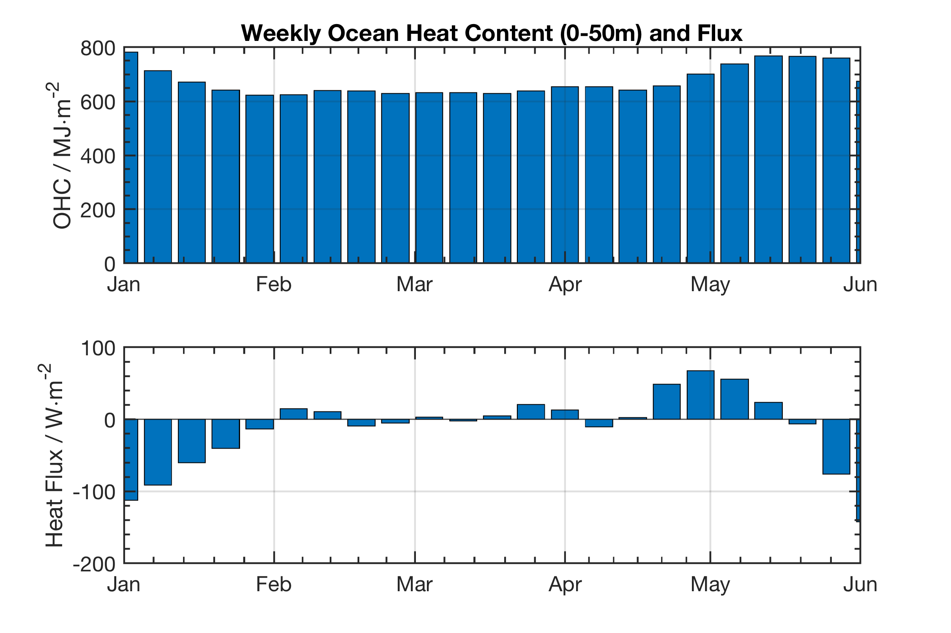
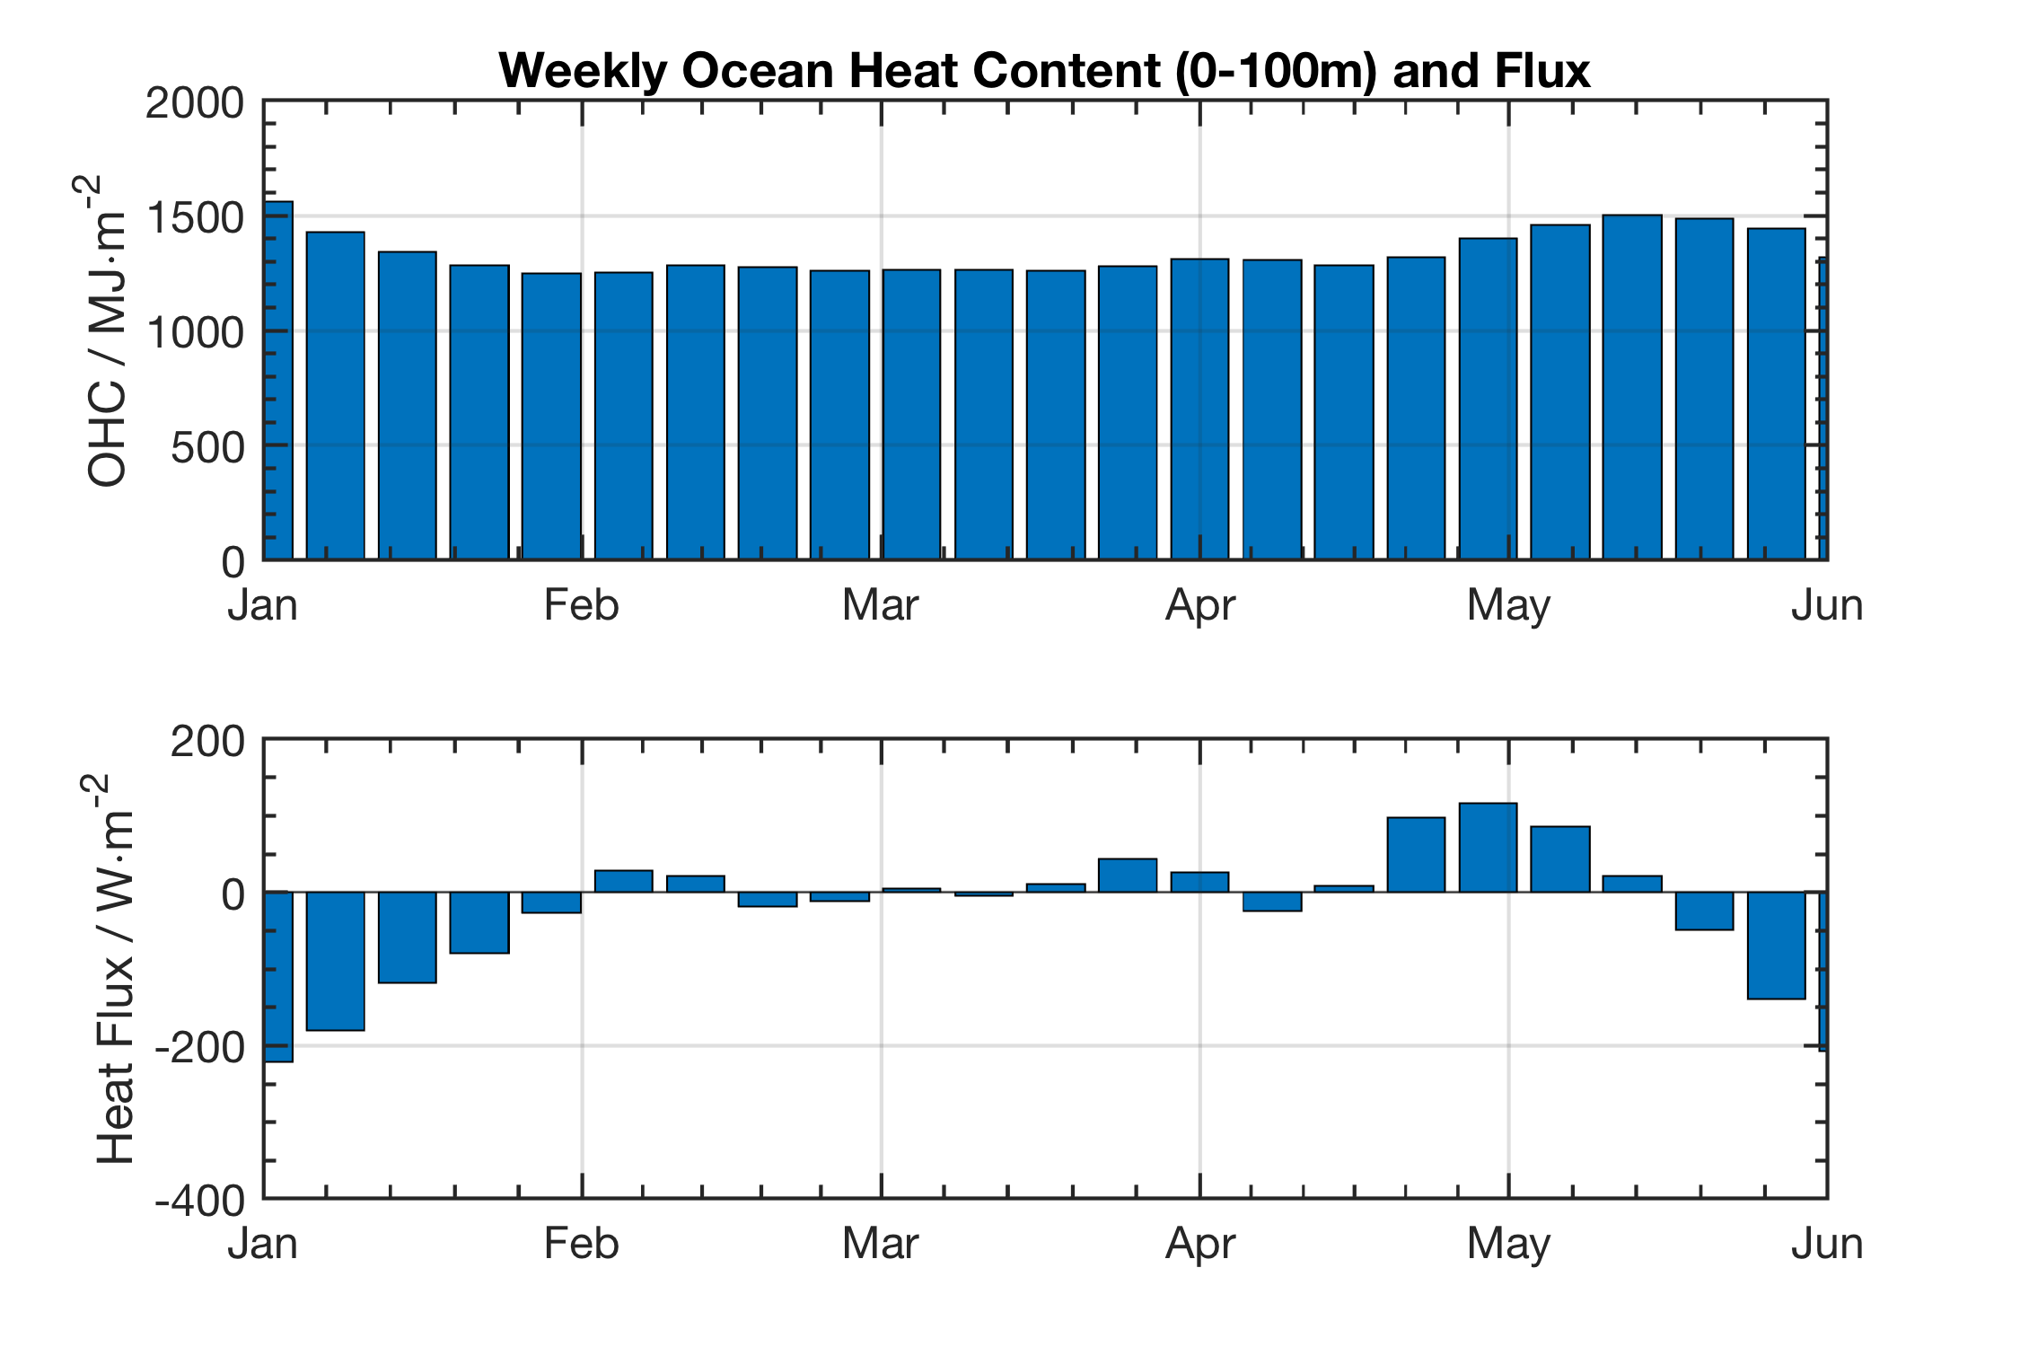
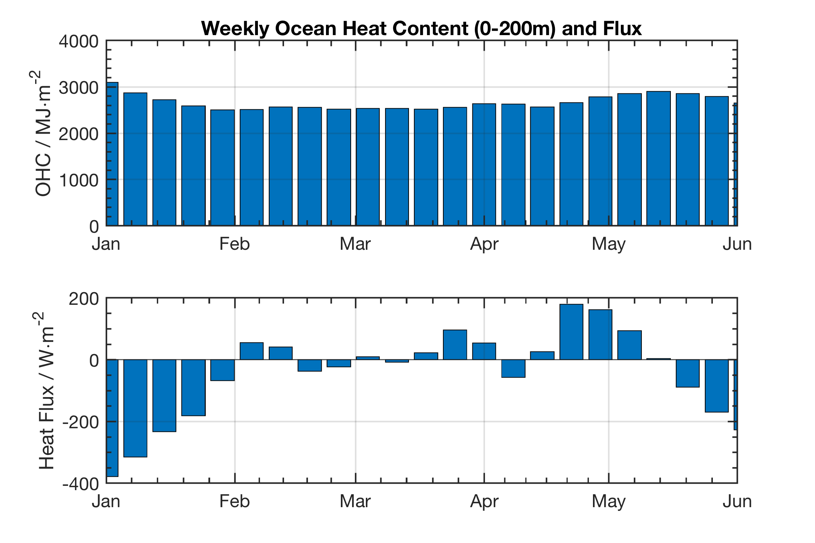
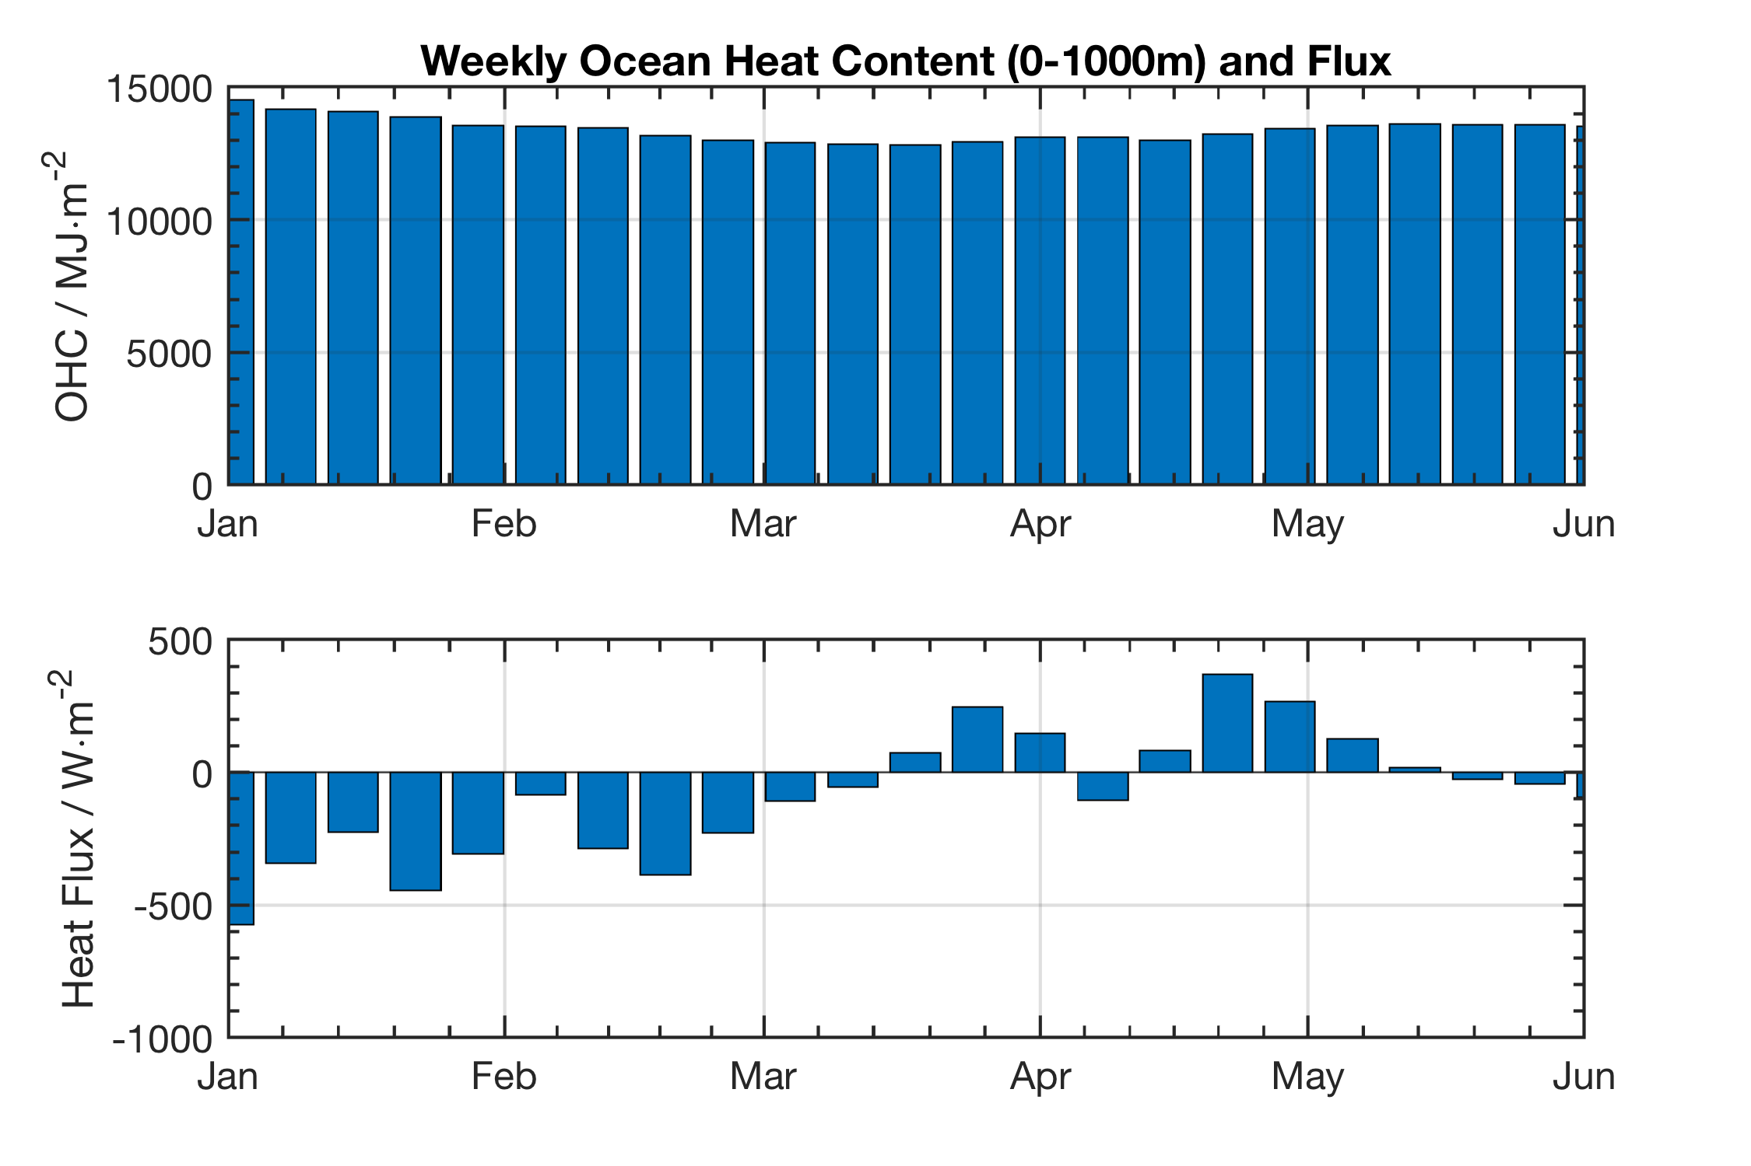
Pearldiver Weekly Ocean Heat Content + Flux
0-1000 m averaged weekly fluxes seem to best agree with ERA5 data.
Gives a plausibility check on the surface behavior and any discrepancy.

Slide 26
Extra Material (NOT Part of JGR Paper)
Eddy Stuff
Oxygen Fluxes in context of large scale ARGO climatology

Slide 27
Methods
Eddy Analysis
Gridding is done on a 1 km (first example) w. smoothing and 3 m in depth
Second case is done with 0.25 km grid, 3 m depth and little smoothing
Smoothing in this case means boxcar averaging (3 rows, 3 columns)
Estimation of eddy edge not satisfactory… arbitrary based on visual inspection of glider data
Need to investigate altimetry and other data sets to properly define edge of the features…

Slide 28
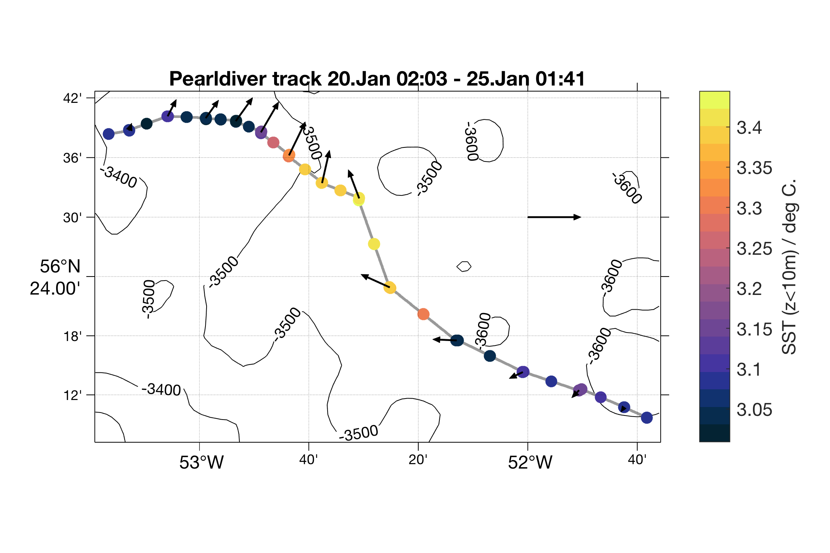
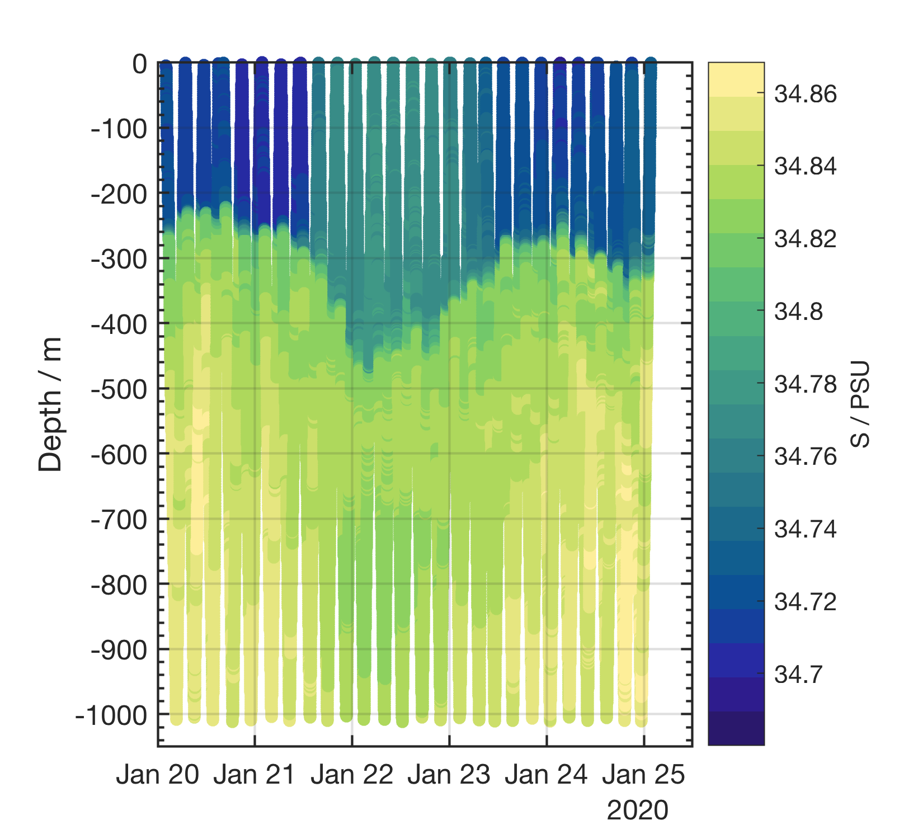
Event 1: January 20 – 25, 2020
Size ~ 80 km, fresh compared to background field
Low velocities from glider track. Eddy not detected in current models.
Out
50 cm/s
In

Slide 29
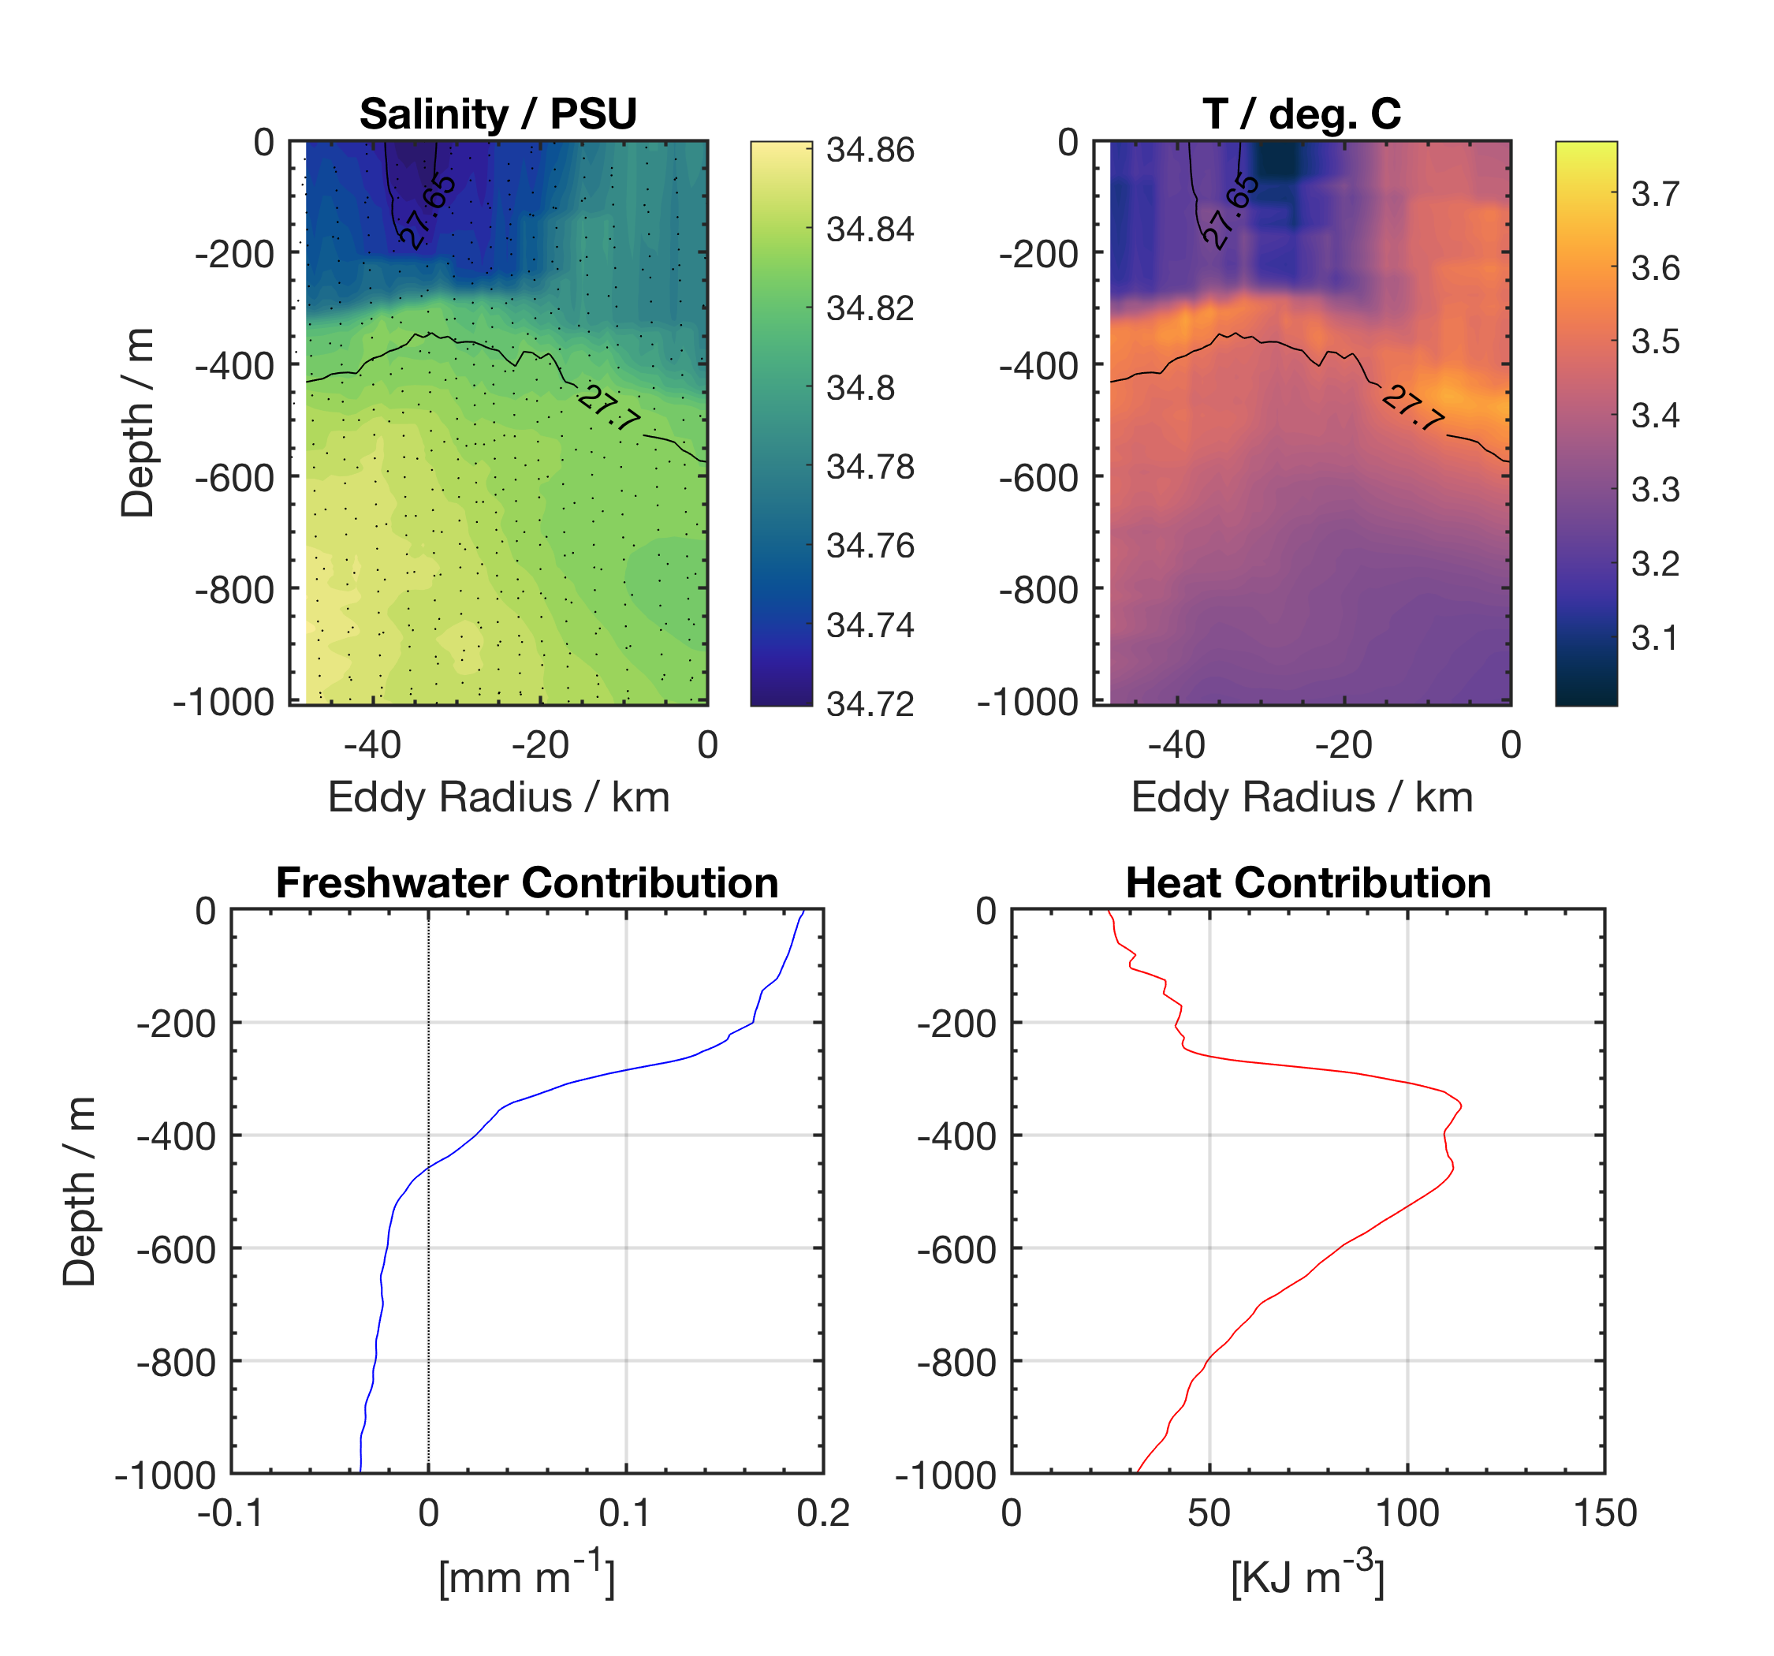
Event 1: January 20 – 25, 2020
Size ~ 80 km, fresh compared to background field
Net input of heat 65 MJ/m^2 and 4 cm of Freshwater to the system
Out
50 cm/s
In

Slide 30
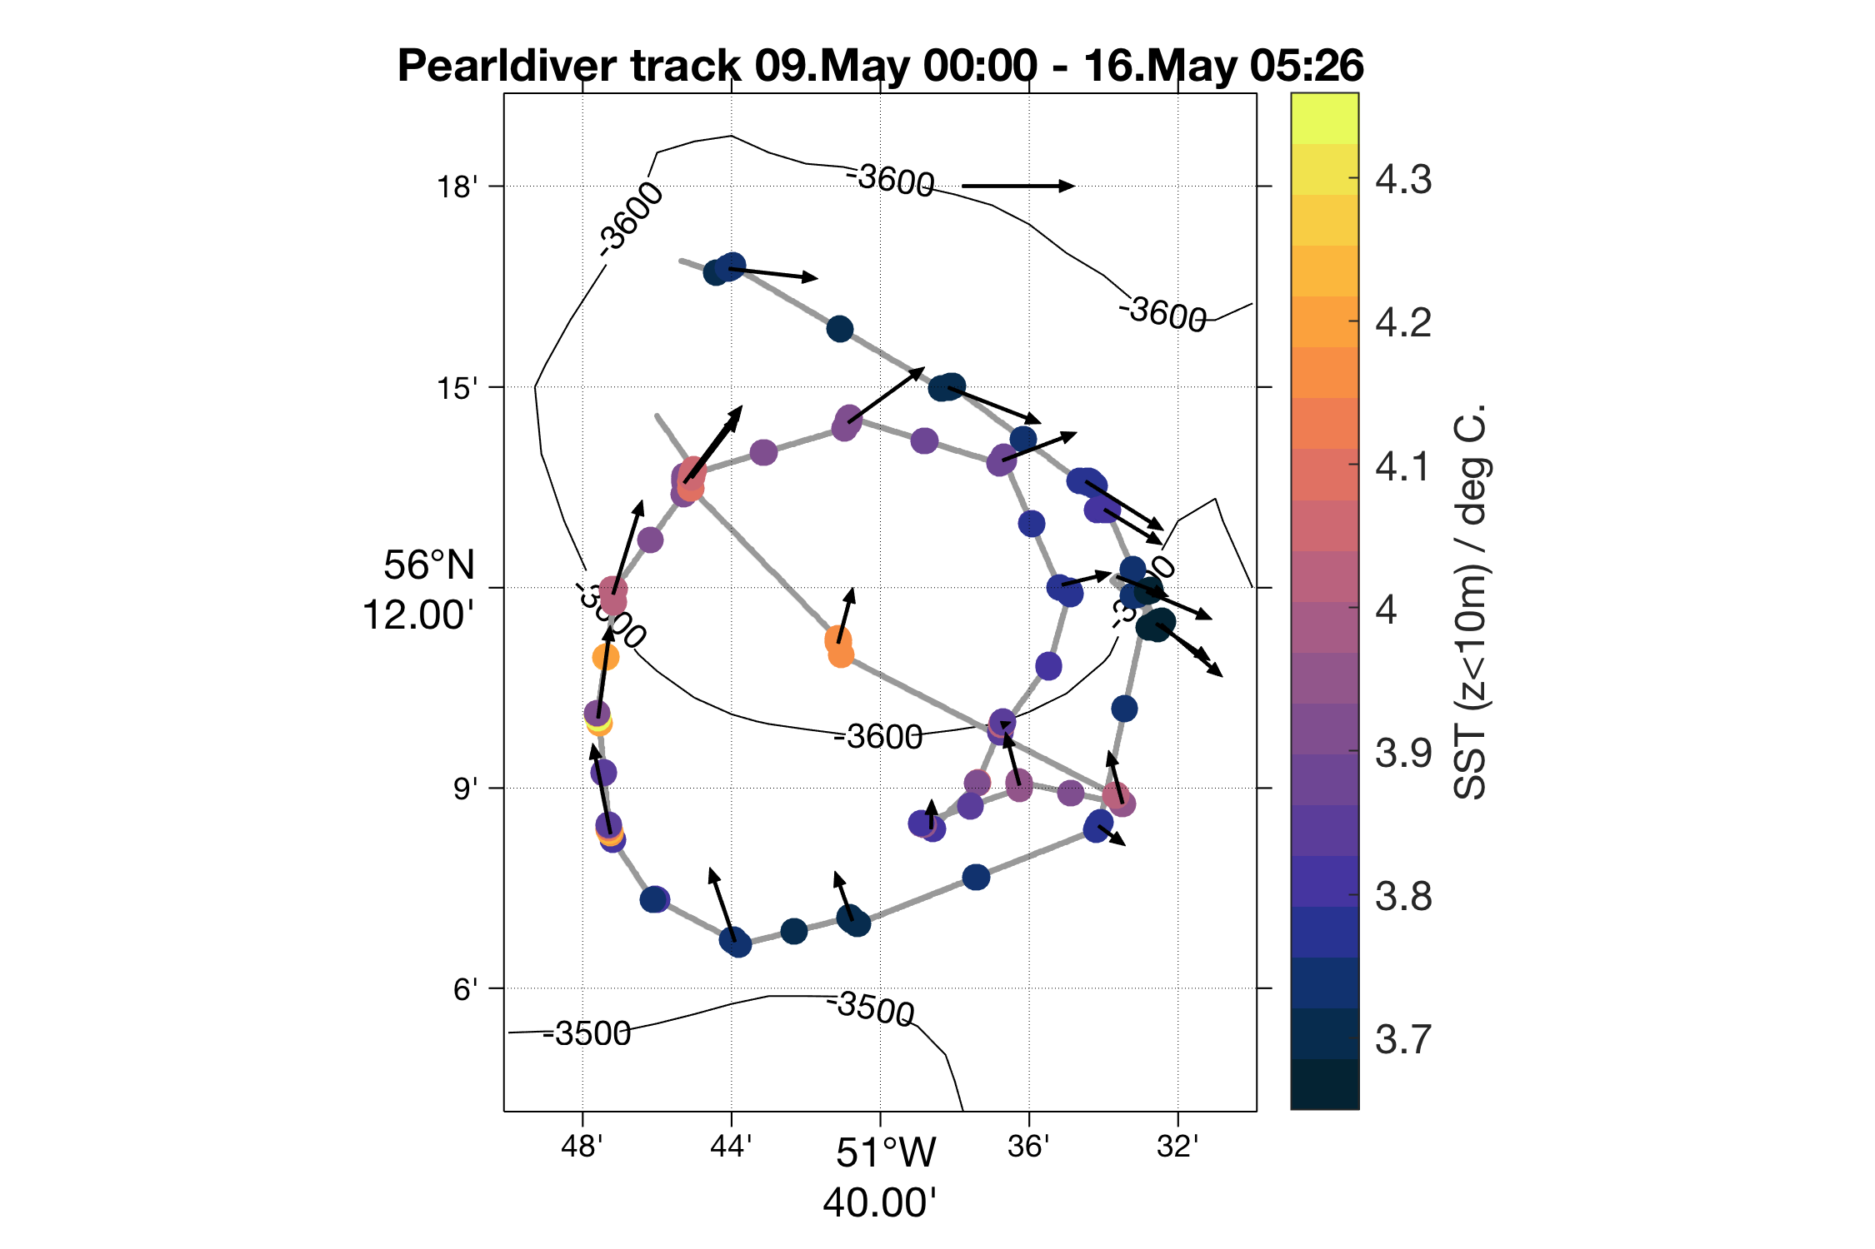
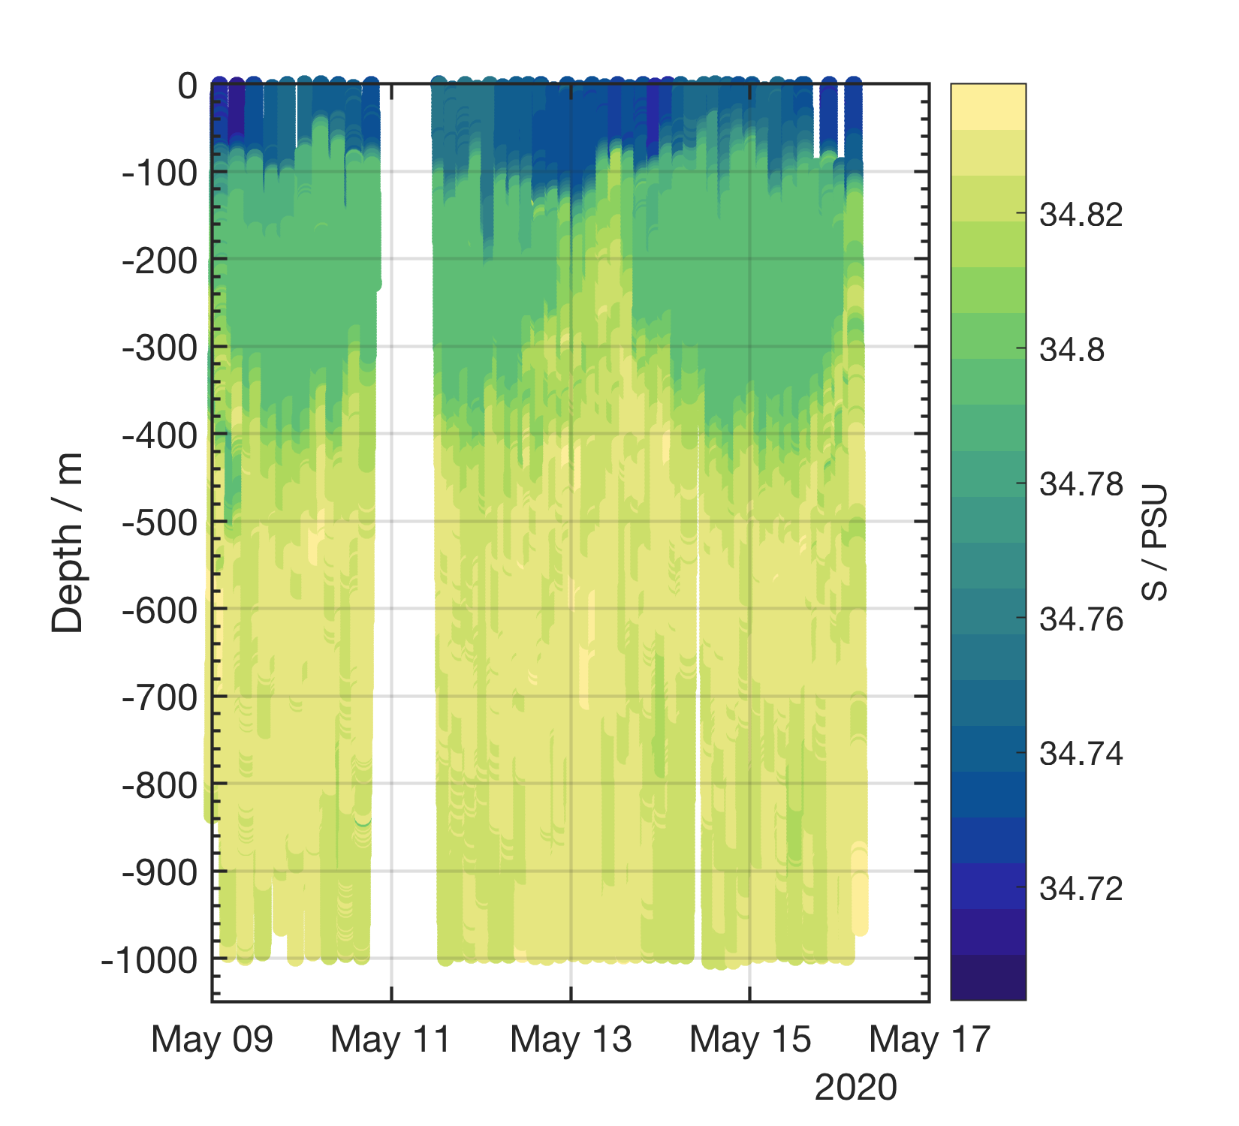
Event 4: May 9 – 16, 2020
Size ~ 35 km, fresh compared to background field
Very energetic for its size (40 cm/s velocities)
In
50 cm/s
Out

Slide 31
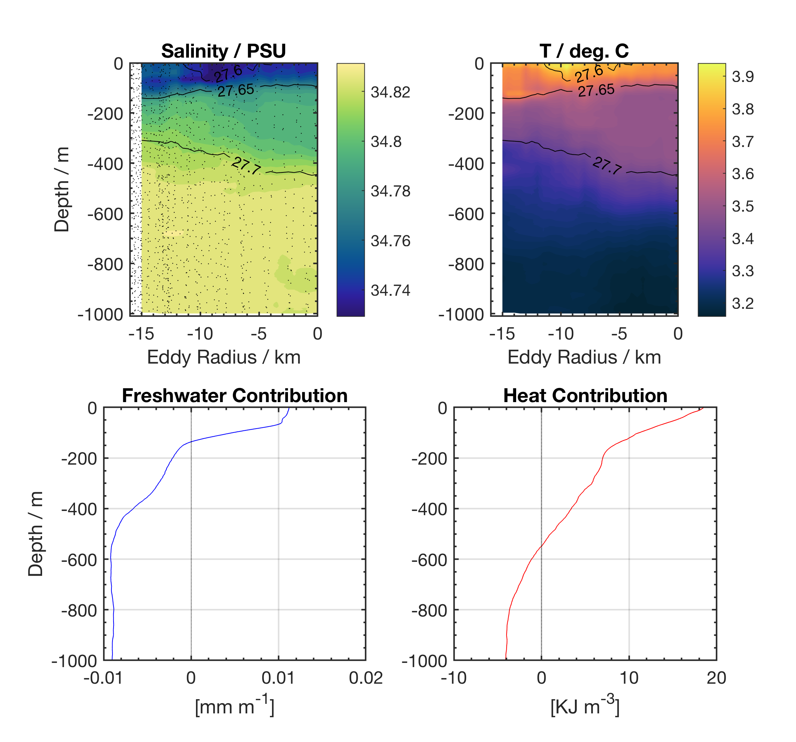
Event 4: May 9 – 16, 2020
Size ~ 35 km, fresh compared to background field
Equivalent of 5.42 MJ/m^2 Input of heat and 4.9 mm input of freshwater
In
50 cm/s
Out

